Slide 1

AGILE
PROJECT MGMT
TRAINER SLIDES · WSQ
Agile Project Management for Business
WSQ Course Code: TGS-2023018967
Conducted by Tertiary Infotech Academy Pte Ltd · UEN: 201200696W
2 days · 16 training hours · TSC: Business Agility (ICT-BIN-4038-1.1)
Version v9.0 · 17 August 2026
© 2026 Tertiary Infotech Academy Pte Ltd. All rights reserved. · www.tertiarycourses.com.sg

Slide 2
COURSE ADMINISTRATION
Welcome & Housekeeping
Agile Project Management for Business · TGS-2023018967
© 2026 Tertiary Infotech Academy Pte Ltd
2

Slide 3
ADMIN · TRAQOM & ATTENDANCE
Digital Attendance (Mandatory)
Three times a day
Take the AM, PM and Assessment digital attendance — mandatory for every WSQ-funded course.
Trainer shows the QR
The trainer or administrator displays the digital attendance QR code from the SSG portal.
1
2
Scan and submit
Scan the QR code with your mobile phone camera and submit your attendance.
75% minimum
A minimum of 75% attendance is required to be eligible for assessment and funding.
3
4
Agile Project Management for Business · TGS-2023018967
© 2026 Tertiary Infotech Academy Pte Ltd
3

Slide 4
ADMIN · YOUR TRAINER (TEMPLATE)
About the Trainer
NAME
__________________________________________________
?
CERTIFICATIONS
__________________________________________________
INDUSTRY EXPERIENCE
__________________________________________________
Your Trainer
AGILE EXPERIENCE
__________________________________________________
WSQ Adult Educator · Agile Practitioner
CONTACT
__________________________________________________
Agile Project Management for Business · TGS-2023018967
© 2026 Tertiary Infotech Academy Pte Ltd
4

Slide 5
ADMIN · YOUR TRAINER
About the Trainer
ROLE
Course developer and principal trainer, Tertiary Infotech Academy
AA
CERTIFICATIONS
Enterprise Design Thinking Practitioner · Agile & Scrum certified · ACTA/DACE
EXPERIENCE
20+ years across engineering, data analytics, AI and digital transformation
Dr Alfred Ang
TEACHES
Agile project management, design thinking, problem solving and analytics
PhD (NUS) · MEng (NTU) · MBA · ACTA/DACE certified adult educator
CONTACT
enquiry@tertiaryinfotech.com · +65 6100 0613
Agile Project Management for Business · TGS-2023018967
© 2026 Tertiary Infotech Academy Pte Ltd
5

Slide 6
ADMIN · HOW WE WORK TOGETHER
Ground Rules
Phones on silent
Set your mobile phone to silent mode for the duration of the session.
Participate actively
No question is a stupid question. This course runs on discussion.
1
2
Mutual respect
Agree to disagree. One conversation at a time.
Be punctual
Return from breaks on time so we finish on schedule.
3
4
Step out quietly
Exit silently for a phone call or a toilet break.
75% attendance
Required to be eligible for assessment and funding.
5
6
Agile Project Management for Business · TGS-2023018967
© 2026 Tertiary Infotech Academy Pte Ltd
6

Slide 7
ADMIN · COURSE MATERIAL
Download Your Course Material
https://lms-tms.tertiaryinfotech.com
1
Open lms-tms.tertiaryinfotech.com in your browser
Log in with the email you registered with
2
Log in with your registered email address
My Courses select Agile Project Management for Business
3
Open this course under 'My Courses'
Courseware Learner Slides · Learner Guide · Activities
4
Download the Learner Guide and slides
Download save the PDF to your laptop before we start
5
Keep them open — the assessment is open book
Everything you need for the activities and the open-book assessment is in the Learner Guide.
Agile Project Management for Business · TGS-2023018967
© 2026 Tertiary Infotech Academy Pte Ltd
7

Slide 8
BY THE END OF THIS COURSE YOU WILL BE ABLE TO
Learning Outcomes
LO1 — Adopt the Agile mindset
Adopt a new Agile mindset for project management, and know when Agile fits and when it does not.
1
LO2 — Share and implement
Share and implement Agile practices within your teams — the Manifesto, Scrum, Lean and Kanban.
2
LO3 — Build, execute and track
Build an Agile team to execute and track project performance with real metrics.
3
Agile Project Management for Business · TGS-2023018967
© 2026 Tertiary Infotech Academy Pte Ltd
8

Slide 9
TSC: Business Agility · ICT-BIN-4038-1.1
Skills Framework — TSC Abilities Assessed
Code
Ability
Where it is taught
A1
Share information actively within and across teams
Topic 2 · Activity 4
A2
Organise work in alignment with operational priorities
Topic 1–2 · Activities 2, 4
A3
Implement Agile or lean practices to reduce waste and defects
Topic 2–3 · Activities 3, 7
A4
Measure progress against targets on a regular basis
Topic 3 · Activities 5, 7, 8
A5
Experiment with new ideas, products or services
Topic 1 · Activity 1
A6
Assess work performance and quality for continuous improvement
Topic 3 · Activities 6, 7, 8
A7
Manage responsibilities and take ownership of outcomes
Topic 3 · Activities 5, 6, 8
Every ability is taught AND practised in a named activity — nothing is assessed that is not taught.
Agile Project Management for Business · TGS-2023018967
© 2026 Tertiary Infotech Academy Pte Ltd
9

Slide 10
TSC: Business Agility · ICT-BIN-4038-1.1
Skills Framework — TSC Knowledge Assessed
Code
Knowledge
Where it is taught
K1
Methods to analyse current and future business operating landscapes
Topic 1 · Activity 2
K2
Methods to analyse current and future customer needs and preferences
Topic 1 · Activity 1
K3
Organisational policies, processes and standards
Topic 1 · Activity 2
K4
Types of change management methodologies, tools and practices
Topic 2
K5
Types of team composition and formation models
Topic 3 · Activities 4, 5
K6
Values and principles of Agile methodologies
Topic 2 · Activity 3
K7
Types of Agile methodologies and practices
Topic 2 · Activity 3
Every knowledge code is taught in a topic AND tested by one question in the Written Assessment.
Agile Project Management for Business · TGS-2023018967
© 2026 Tertiary Infotech Academy Pte Ltd
10

Slide 11
DAY 1 · THE AGILE MINDSET AND THE ESSENTIALS
Lesson Plan — Day 1
1
09:30 Welcome & admin
Digital attendance (AM) · introductions · ground rules · outcomes
2
11:00 Topic 1
Introduction to Agile Project Management (Activities 1–2)
3
13:00 Lunch break
1 hour · digital attendance (PM) on return
4
16:45 Topic 2
Agile Essentials begins (Activities 3–4 on Day 2)
5
18:30 End of Day 1
Recap and Q&A
Agile Project Management for Business · TGS-2023018967
© 2026 Tertiary Infotech Academy Pte Ltd
11

Slide 12
DAY 2 · BUILDING AND RUNNING AN AGILE TEAM
Lesson Plan — Day 2
1
09:30 Digital attendance (AM)
Recap of Day 1
2
09:45 Topic 2 continued
Lean · Kanban · XP · change management (Activities 3–4)
3
13:00 Lunch break
1 hour · digital attendance (PM) on return
4
14:45 Topic 3
Agile Project Execution and Tracking (Activities 5–8)
5
18:30 Feedback & TRAQOM
Course feedback and the mandatory TRAQOM survey
6
19:00 Final Assessment
Digital attendance (Assessment) · WA (1 h) + Case Study (1 h)
Agile Project Management for Business · TGS-2023018967
© 2026 Tertiary Infotech Academy Pte Ltd
12

Slide 13
WHAT WE COVER OVER 2 DAYS · 16 TRAINING HOURS
Course Outline
Topic 1 — Introduction to Agile Project Management
Business landscape · Waterfall · Agile overview · The paradigm shift · K1, K2, K3, A2, A5
1
Topic 2 — Agile Essentials
Manifesto values & principles · Scrum · Lean · Kanban · XP · Overcoming resistance · K4, K6, K7, A1, A3
2
Topic 3 — Agile Project Execution and Tracking
Team building & vision · User stories & estimation · Execution · Metrics · Continuous improvement · K5, A4, A6, A7
3
Agile Project Management for Business · TGS-2023018967
© 2026 Tertiary Infotech Academy Pte Ltd
13

Slide 14
HANDS-ON TOOLING · BROWSER-BASED, NOTHING TO INSTALL
The Six Tools You Will Use
1
5 Whys
2
Fishbone
3
Pareto Chart
Root-cause analysis in the sprint retrospective (Activity 6) https://alfredang.github.io/5whys/
Cause-and-effect analysis of delivery problems (Activity 2) https://alfredang.github.io/fishbone/
Prioritising the 20% of causes driving 80% of defects (Activity 7) https://alfredang.github.io/paretochart/
4
RACI Matrix
5
Scrum Board
6
Design Thinking
Clarifying Agile role accountability (Activity 4) https://alfredang.github.io/raci/
Running the sprint board, backlog and burndown (Activities 3, 5, 8) https://alfredang.github.io/scrum/
Empathising with customers to shape the product vision (Activity 1) https://alfredang.github.io/designthinking/
HOW WE WORK
Every activity uses a real browser-based tool on a single running case study — HarbourFront Logistics, a Singapore 3PL whose customer portal failed as a waterfall project.
Agile Project Management for Business · TGS-2023018967
© 2026 Tertiary Infotech Academy Pte Ltd
14

Slide 15
THE RUNNING CASE
One case study runs through all 8 activities.
HarbourFront Logistics Pte Ltd — a 140-staff Singapore third-party logistics provider whose 'CustomerConnect' portal shipped 4 months late with 62% of its features unused. You will diagnose it, restart it with Agile, run its sprints, and forecast its release.
Agile Project Management for Business · TGS-2023018967
© 2026 Tertiary Infotech Academy Pte Ltd
15

Slide 16
ASSESSMENT · BRIEFING
Briefing for Assessment
Clear your table
Place phones and other materials under the table or on the floor.
No photos or recording
Assessment scripts must not be photographed or recorded.
1
2
No discussion
Work individually once the assessment starts.
Black or blue pen
Use a black or blue pen for hard-copy scripts.
3
4
No correction fluid
Do not use liquid paper or correction tape.
Scripts collected
Scripts are collected when the time is up.
5
6
Agile Project Management for Business · TGS-2023018967
© 2026 Tertiary Infotech Academy Pte Ltd
16

Slide 17
ASSESSMENT · WHAT TO EXPECT
Final Assessment
1
Written Assessment (WA)
Written Assessment (WA) — Short-Answer Questions (SAQ), 1 hour, open book.
2
Case Study (CS)
Case Study (CS) — an applied business scenario with structured tasks, 1 hour, open book.
3
Open book
Open book: slides, Learner Guide and approved course materials only.
4
Competency
A minimum of 75% attendance is required to be eligible for assessment and funding. Learners must be assessed Competent in both instruments.
Agile Project Management for Business · TGS-2023018967
© 2026 Tertiary Infotech Academy Pte Ltd
17

Slide 18
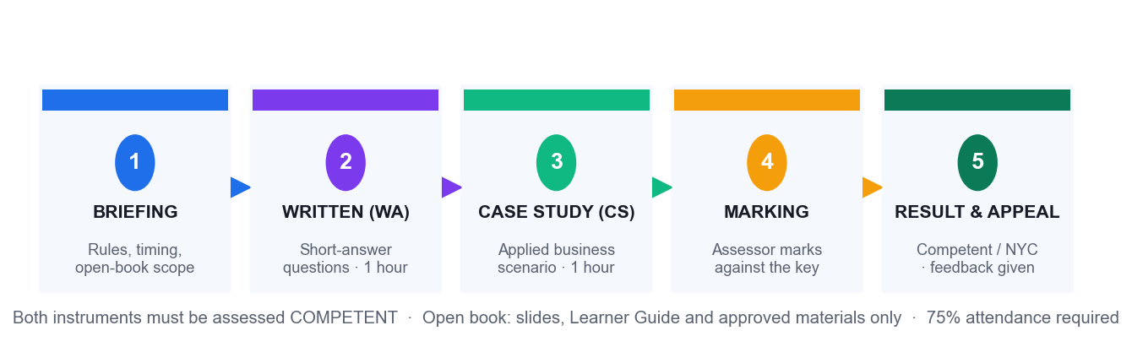
ASSESSMENT · END-TO-END FLOW
Assessment Flow
Briefing → Written Assessment → Case Study → marking → result, with an appeal route at every stage.
Agile Project Management for Business · TGS-2023018967
© 2026 Tertiary Infotech Academy Pte Ltd
18

Slide 19
ADMIN · FUNDING ELIGIBILITY
Criteria for Funding
75% attendance
Minimum attendance rate of 75%, based on the SSG digital attendance record.
1
Assessed Competent
Complete both assessment instruments and be assessed as 'Competent'.
2
TRAQOM survey
Complete the mandatory course feedback and TRAQOM survey.
3
Agile Project Management for Business · TGS-2023018967
© 2026 Tertiary Infotech Academy Pte Ltd
19

Slide 20
01
TOPIC 01
Introduction to Agile Project Management
Business landscape · Waterfall · Agile overview · The paradigm shift · LO1 · K1, K2, K3, A2, A5
Agile Project Management for Business · TGS-2023018967
© 2026 Tertiary Infotech Academy Pte Ltd
20

Slide 21
TOPIC 01 · THE CENTRAL QUESTION
Are we building the right thing?
Traditional project management asks whether we are building the thing right — on time, on budget, to specification. Agile asks the prior question first, and keeps asking it.
Agile Project Management for Business · TGS-2023018967
© 2026 Tertiary Infotech Academy Pte Ltd
21

Slide 22
TOPIC 01 · WHERE WE ARE COMING FROM
The Traditional Project Lifecycle
1
2
3
4
5
▶
▶
▶
▶
Initiate
Plan
Execute
Monitor
Close
charter, sponsor, business case
scope, WBS, schedule, budget
build to the approved plan
variance against the baseline
handover and lessons learned
Nothing here is wrong. It is simply built on an assumption: that the plan written at the start remains a good description of reality until the end.
Agile Project Management for Business · TGS-2023018967
© 2026 Tertiary Infotech Academy Pte Ltd
22

Slide 23
TOPIC 01 · THE PROBLEM SPACE
The Challenges Every Project Manager Recognises
1
Scope creep
Requirements change after sign-off, and every change costs a variation order.
2
Resource constraints
Not enough people, or not enough of the right people at the right time.
3
Unrealistic schedules
Dates set by commitment or hope rather than by capacity.
4
Unproven technology
Platforms chosen early and validated far too late.
5
Documentation burden
Reporting effort that grows faster than delivery effort.
6
Too many dependencies
One late input stalls a whole chain of work.
7
Stakeholder expectations
Different stakeholders holding different pictures of 'done'.
8
Late discovery
The biggest problems surface in the final third, when change is most expensive.
Agile Project Management for Business · TGS-2023018967
© 2026 Tertiary Infotech Academy Pte Ltd
23

Slide 24
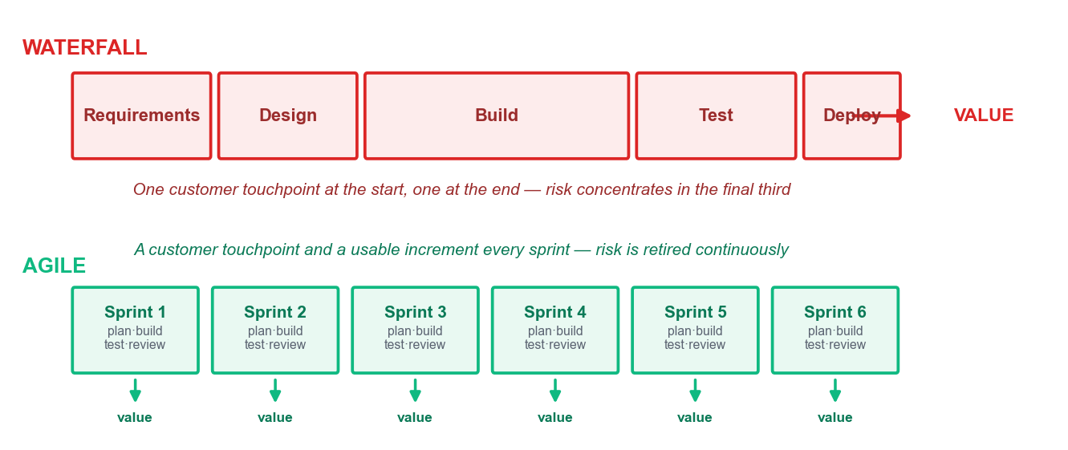
TOPIC 01 · THE WATERFALL MODEL
Understanding the Waterfall Model
Scope frozen at the start
The end product is fixed in all respects when the project begins.
Detailed upfront estimation
Requires complete estimation and planning before any build.
Change is a cost event
Mid-course changes cause delays and formal variation orders.
One integration point
The parts meet late, so integration risk peaks at the worst moment.
Agile Project Management for Business · TGS-2023018967
© 2026 Tertiary Infotech Academy Pte Ltd
24

Slide 25
TOPIC 01 · WHY IT STRUGGLES
Challenges with the Waterfall Model
Change is hostile
Managing changing requirements mid-lifecycle fights the model rather than using it.
Late visibility
Nobody sees the end product until the end of the lifecycle.
1
2
Risk loading
Risk and uncertainty concentrate at the point where they are most expensive to fix.
Complexity upfront
The model asks you to fully understand a complex problem before you have built anything.
3
4
Agile Project Management for Business · TGS-2023018967
© 2026 Tertiary Infotech Academy Pte Ltd
25

Slide 26
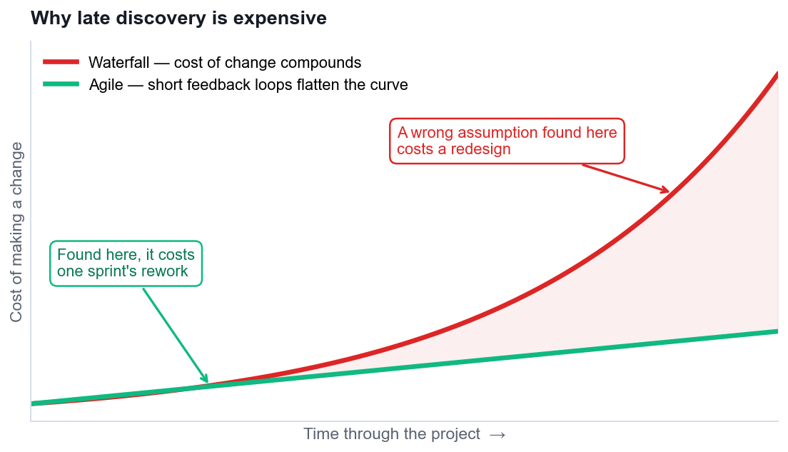
TOPIC 01 · WHY LATE DISCOVERY IS EXPENSIVE
The Cost of Change
This single curve is the economic argument for short iterations — it is not about speed, it is about the price of being wrong.
Agile Project Management for Business · TGS-2023018967
© 2026 Tertiary Infotech Academy Pte Ltd
26

Slide 27
TOPIC 01 · DEFINING AGILE
What Agile Actually Is
1
An umbrella term
2
Iterative delivery
3
Built for software, used everywhere
4
A mindset, not a ceremony
Agile covers many iterative, incremental methods — it is not one process.
APM: 'an iterative approach to delivering a project throughout its life cycle'.
Now standard in marketing, finance, HR, construction and biotech.
Running stand-ups without changing how decisions are made is not Agile.
THE CORE IDEA
Deliver in small increments, get feedback from real users, and let what you learn change what you build next. Everything else in this course is machinery for doing that reliably.
Agile Project Management for Business · TGS-2023018967
© 2026 Tertiary Infotech Academy Pte Ltd
27

Slide 28
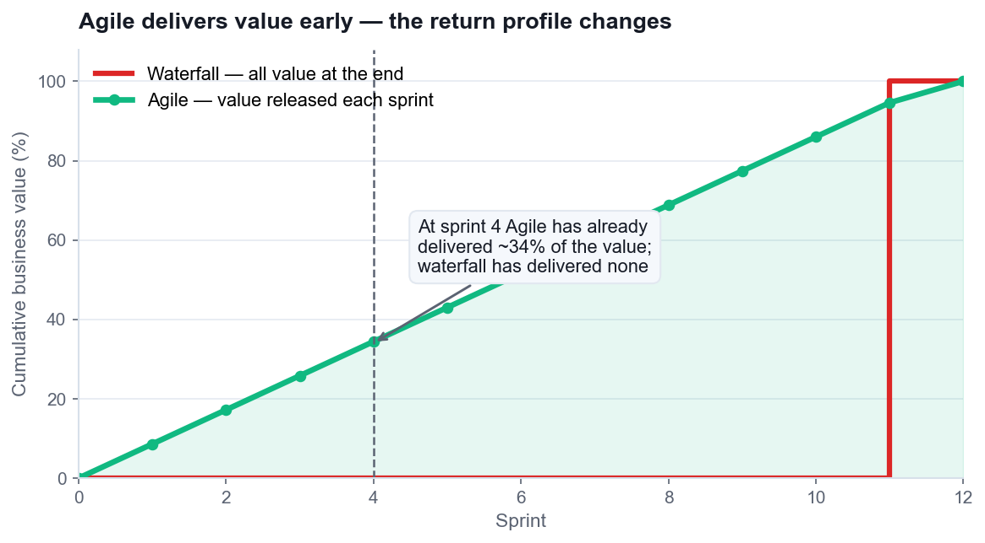
TOPIC 01 · THE SHIFT
Agile vs Traditional Project Management
Builds in increments
Rather than delivering the whole product as one event.
Plans continuously
Planning happens throughout, not only at the start.
Customer sees value faster
Benefit is released during the project, not after it.
Change is welcomed
Change is expected and priced in, not resisted.
Agile Project Management for Business · TGS-2023018967
© 2026 Tertiary Infotech Academy Pte Ltd
28

Slide 29
TOPIC 01 · SIDE BY SIDE
Comparison of Agile and Waterfall
Aspect
Waterfall / Traditional
Agile
Approach
Sequential phases, one pass
Iterative and incremental
Requirements
Fixed and signed off upfront
Emerge and are re-ordered continuously
Flexibility
Resists change after planning
Adapts throughout
Customer role
Consulted at start and at UAT
Continuous collaboration
Delivery
One release at the end
A usable increment every sprint
Risk
Addressed upfront, realised late
Retired continuously
Documentation
Comprehensive by mandate
Barely sufficient, just in time
Team structure
Hierarchical, specialised roles
Self-organising, cross-functional
Neither column is 'better'. The right question is which column matches the uncertainty of YOUR work.
Agile Project Management for Business · TGS-2023018967
© 2026 Tertiary Infotech Academy Pte Ltd
29

Slide 30
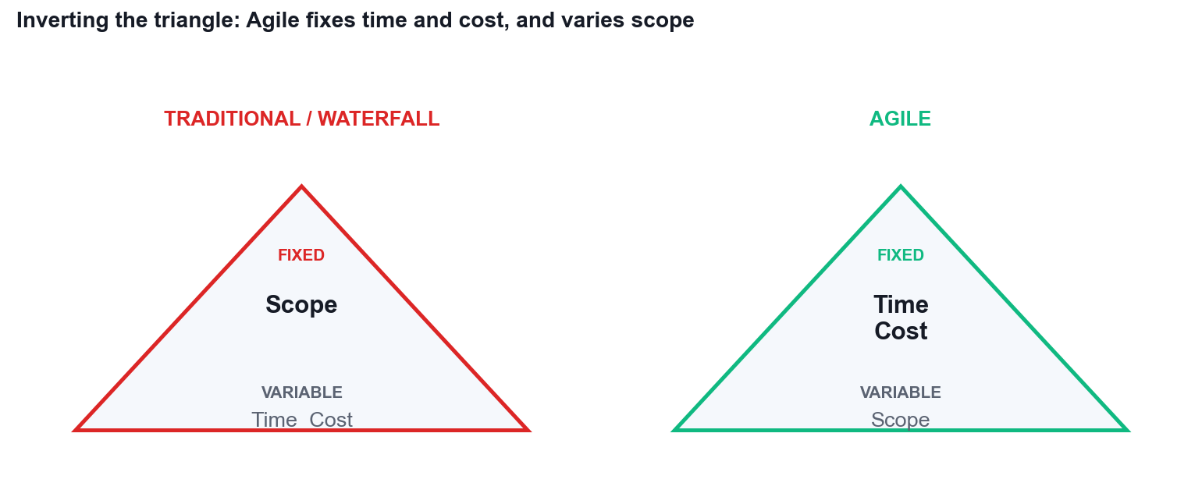
TOPIC 01 · THE PARADIGM SHIFT
Inverting the Triangle
Waterfall fixes scope
Time and cost flex to deliver the agreed feature list.
Agile fixes time and cost
You buy a stable team and a timebox; scope is the variable.
This is the real trade
You cannot fix all three and still respond to what you learn.
Implication for governance
Funding shifts from one big approval to incremental funding decisions.
Agile Project Management for Business · TGS-2023018967
© 2026 Tertiary Infotech Academy Pte Ltd
30

Slide 31
TOPIC 01 · K1 · METHODS AND TOOLS
Analysing the Business Operating Landscape (K1)
PESTLE
Political, economic, social, technological, legal and environmental forces reshaping the market.
SWOT
Internal strengths and weaknesses against external opportunities and threats.
1
2
Porter's Five Forces
Competitive rivalry, supplier and buyer power, substitutes and new entrants.
Scenario planning
Several plausible futures rather than one forecast, each with a response.
3
4
VUCA framing
Volatility, uncertainty, complexity and ambiguity — name which one you actually face.
Re-run the analysis
The Agile difference: quarterly, not once per project.
5
6
Agile Project Management for Business · TGS-2023018967
© 2026 Tertiary Infotech Academy Pte Ltd
31

Slide 32
TOPIC 01 · K2 · METHODS AND TOOLS
Analysing Customer Needs and Preferences (K2)
Personas & empathy maps
What the customer says, thinks, does and feels — used in Activity 1.
Journey maps
The end-to-end experience, exposing where the pain actually sits.
1
2
Jobs to be done
The progress the customer is trying to make, not the feature they requested.
Kano analysis
Sorting delighters, satisfiers, must-haves and indifferent features.
3
4
A/B experiments
Testing a preference with real behaviour instead of asking an opinion.
Continuous feedback
Sprint reviews turn customer contact into a rhythm, not an event.
5
6
Agile Project Management for Business · TGS-2023018967
© 2026 Tertiary Infotech Academy Pte Ltd
32

Slide 33
TOPIC 01 · IT IS NOT JUST FOR SOFTWARE
Agile Beyond Software — Business Use Cases
Adobe · marketing
Campaign teams run sprints and retrospectives to adapt messaging to live data.
Toyota · manufacturing
The origin of Lean and Kanban — flow, WIP limits and waste elimination.
1
2
Spotify · product delivery
Autonomous squads optimised for delivery speed and learning.
PayPal · workforce alignment
Agile used to align large distributed teams on shared outcomes.
3
4
Banking · compliance delivery
Hybrid Agile inside regulated stage-gate governance.
Construction & biotech
Iterative design and staged validation where rework is costly.
5
6
Agile Project Management for Business · TGS-2023018967
© 2026 Tertiary Infotech Academy Pte Ltd
33

Slide 34
TOPIC 01 · HOW AGILE PEOPLE THINK
The Agile Mindset
1
Welcoming change rather than resisting it
2
Working in small increments of real value
3
Using build-and-feedback loops to learn
4
Learning through discovery instead of assumption
5
Value-driven development, not activity-driven
6
Failing fast, and extracting the lesson
7
Continuous delivery of working outcomes
8
Continuous improvement of how the team works
Agile Project Management for Business · TGS-2023018967
© 2026 Tertiary Infotech Academy Pte Ltd
34

Slide 35
TOPIC 01 · INTELLECTUAL HONESTY
When Agile Is NOT the Right Answer
1
Truly fixed scope
2
No customer access
3
Physical irreversibility
4
No mandate to change governance
A regulatory submission with a legislated, unchangeable specification.
If nobody can give feedback each sprint, the feedback loop is theatre.
Where an increment cannot be built and changed cheaply.
Agile teams inside stage-gate funding produce reports, not agility.
CHOOSE DELIBERATELY
Stable requirements and a documentation mandate favour waterfall; evolving requirements and high novelty favour Agile. Most real organisations run a considered hybrid.
Agile Project Management for Business · TGS-2023018967
© 2026 Tertiary Infotech Academy Pte Ltd
35

Slide 36
WHAT YOU'LL DO
Hands-On Activities — Introduction to Agile Project Management
1
Activity 1 · Empathise with the Customer to Reframe a Failing Project
2
Activity 2 · Diagnose the Waterfall Failure with a Fishbone Analysis
Tool: Design Thinking 45 minutes · LO1
Tool: Fishbone 45 minutes · LO1
ALL ON ONE CASE
Every activity in this topic advances the same HarbourFront CustomerConnect case, so the artefacts you build compound.
Agile Project Management for Business · TGS-2023018967
© 2026 Tertiary Infotech Academy Pte Ltd
36

Slide 37

ACTIVITY 1 · TOOL
The Tool — Design Thinking
Open it in your browser
https://alfredang.github.io/designthinking/
No install, no login
It runs in the browser. Work on one shared screen as a team.
Build the artefact
The deliverable named on the next slide.
Export it
Screenshot or export into your Activity worksheet.
Activity 1 · 45 minutes · full step-by-step: Learner Guide, Activity 1
Agile Project Management for Business · TGS-2023018967
© 2026 Tertiary Infotech Academy Pte Ltd
37

Slide 38
TOPIC 01 · HANDS-ON ACTIVITY
ACTIVITY 1 · 45 MIN
Empathise with the Customer to Reframe a Failing Project
THE SITUATION
HarbourFront Logistics spent 11 months building the CustomerConnect portal from a signed-off 96-page requirements document. Six months after launch, only 3 of 24 features are used weekly. The top customer complaint to the call centre is still "where is my shipment right now?" — a question the portal was supposed to answer. You are the newly appointed Agile project lead. Before writing a single new requirement, you must understand the customer.
WHAT YOU'LL DO
YOU'LL PRODUCE
DONE WHEN
Working in teams of 3–4 as the CustomerConnect project team, you use the Design Thinking tool to build an empathy map and a persona for Priya Menon, a warehouse operations executive at a HarbourFront customer who tracks 40–60 inbound shipments a week. You then reframe the original requirement statement into a customer-value problem statement and identify the three highest-value features to deliver first.
A completed empathy map and persona for Priya Menon, a reframed problem statement, and a ranked list of the top 3 customer-value features with the reasoning for each.
Your reframed problem statement names a specific user, a specific need and a specific consequence — and contains no solution or technology. Your top 3 features each state a customer benefit. If any 'feature' is a module name or a format, it is still a requirement, not a value statement — rewrite it.
ACT 1
Tool: Design Thinking — https://alfredang.github.io/designthinking/
LO 1 · Analyse current and future customer needs and preferences using Design Thinking to reframe requirements around customer value (K2, A5). · Full step-by-step: Learner Guide, Activity 1
Agile Project Management for Business · TGS-2023018967
© 2026 Tertiary Infotech Academy Pte Ltd
38

Slide 39
TOPIC 01 · ACTIVITY 1 DEBRIEF
Debrief — Activity 1: What It Proves
The original project delivered exactly what was signed off, and still failed. Signed-off scope is not the same as delivered value.
1
Empathising took 45 minutes. It would have changed 11 months of build.
2
This is K2 in practice: analysing current and future customer needs is a repeatable method, not an intuition.
3
SUCCESS CRITERION
Your reframed problem statement names a specific user, a specific need and a specific consequence — and contains no solution or technology. Your top 3 features each state a customer benefit. If any 'feature' is a module name or a format, it is still a requirement, not a value statement — rewrite it.
Agile Project Management for Business · TGS-2023018967
© 2026 Tertiary Infotech Academy Pte Ltd
39

Slide 40
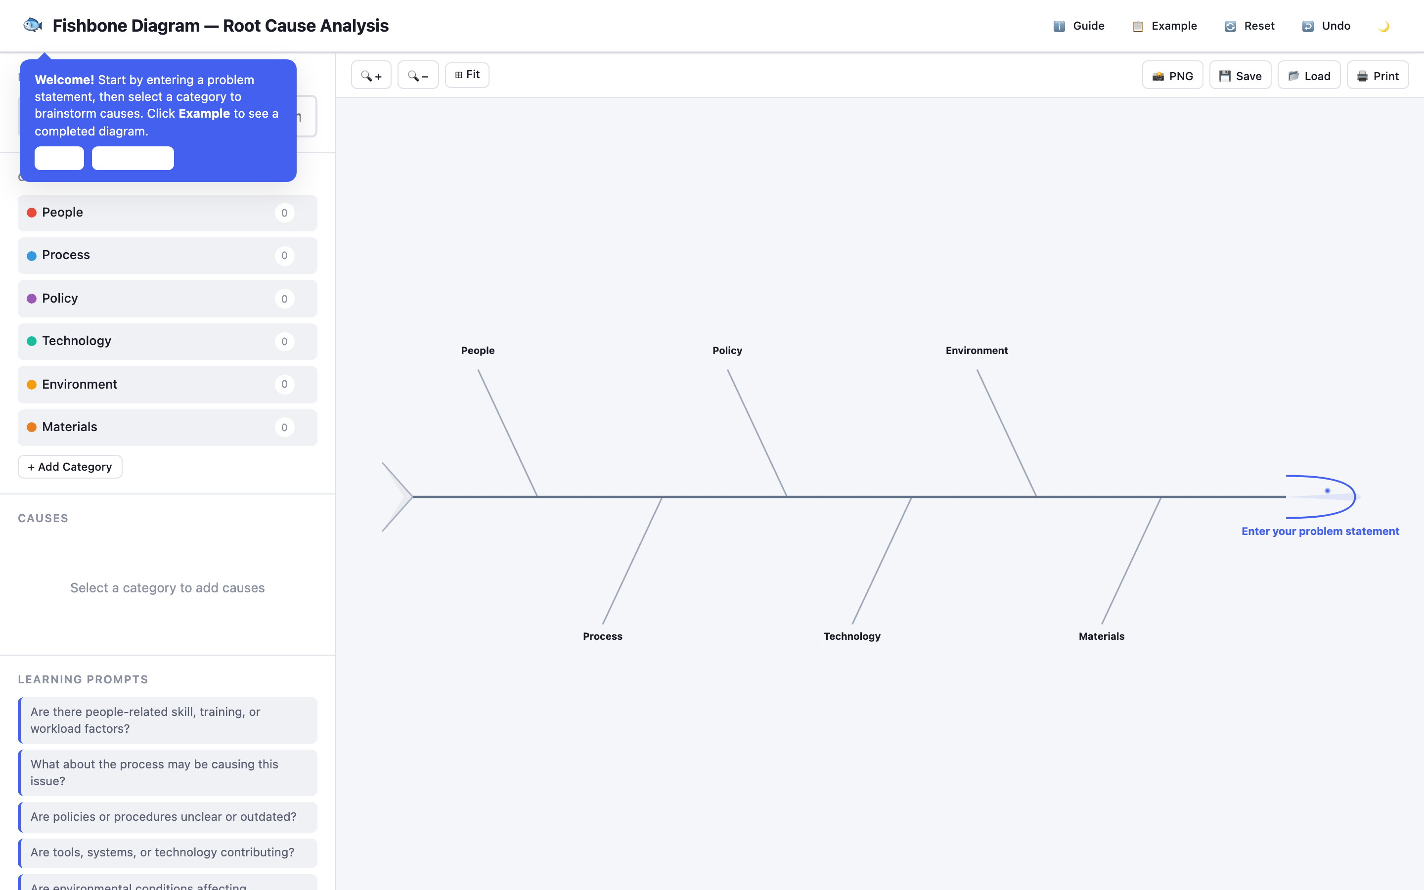
ACTIVITY 2 · TOOL
The Tool — Fishbone
Open it in your browser
https://alfredang.github.io/fishbone/
No install, no login
It runs in the browser. Work on one shared screen as a team.
Build the artefact
The deliverable named on the next slide.
Export it
Screenshot or export into your Activity worksheet.
Activity 2 · 45 minutes · full step-by-step: Learner Guide, Activity 2
Agile Project Management for Business · TGS-2023018967
© 2026 Tertiary Infotech Academy Pte Ltd
40

Slide 41
TOPIC 01 · HANDS-ON ACTIVITY
ACTIVITY 2 · 45 MIN
Diagnose the Waterfall Failure with a Fishbone Analysis
THE SITUATION
The HarbourFront management committee wants to know why CustomerConnect was 4 months late and 62% unused before it approves any new funding. The programme director's explanation was "the team underestimated". The CEO is not satisfied with that answer and has asked your team for a structured diagnosis by Friday.
WHAT YOU'LL DO
YOU'LL PRODUCE
DONE WHEN
Your team uses the Fishbone (Ishikawa) tool to analyse the problem statement 'CustomerConnect delivered late and mostly unused'. You populate six cause categories, identify which causes are structural to the waterfall approach rather than failures of individual effort, and mark which ones an Agile approach would actually address. You then write a one-page recommendation to the committee.
A completed fishbone diagram with 6 categories and at least 18 causes, each tagged as structural or behavioural, plus a one-page recommendation identifying which causes Agile addresses and which it does not.
Your diagram carries at least 18 causes across all 6 categories, every cause is tagged S or B, and each structural cause is paired with a named Agile practice. Your recommendation honestly identifies at least two causes Agile will not fix — a diagnosis that concludes 'Agile solves everything' has not been done properly.
ACT 2
Tool: Fishbone — https://alfredang.github.io/fishbone/
LO 1 · Analyse the current business operating landscape and diagnose why a waterfall delivery failed, using cause-and-effect analysis (K1, K3, A2). · Full step-by-step: Learner Guide, Activity 2
Agile Project Management for Business · TGS-2023018967
© 2026 Tertiary Infotech Academy Pte Ltd
41

Slide 42
TOPIC 01 · ACTIVITY 2 DEBRIEF
Debrief — Activity 2: What It Proves
Most causes tag as structural. The team did not fail; the approach concentrated all risk at the end.
1
This is why the cost-of-change curve matters: every one of these causes became expensive because it was discovered late.
2
K3 in practice: organisational policies and governance had to change too. Adopting Agile inside a stage-gate funding model produces theatre, not agility.
3
SUCCESS CRITERION
Your diagram carries at least 18 causes across all 6 categories, every cause is tagged S or B, and each structural cause is paired with a named Agile practice. Your recommendation honestly identifies at least two causes Agile will not fix — a diagnosis that concludes 'Agile solves everything' has not been done properly.
Agile Project Management for Business · TGS-2023018967
© 2026 Tertiary Infotech Academy Pte Ltd
42

Slide 43
TOPIC RECAP · LO1 · K1, K2, K3, A2, A5
Recap — Introduction to Agile Project Management
Activity 1 · Empathise with the Customer to Reframe a Failing Project
Analyse current and future customer needs and preferences using Design Thinking to reframe requirements around customer value (K2, A5).
1
Activity 2 · Diagnose the Waterfall Failure with a Fishbone Analysis
Analyse the current business operating landscape and diagnose why a waterfall delivery failed, using cause-and-effect analysis (K1, K3, A2).
2
Agile Project Management for Business · TGS-2023018967
© 2026 Tertiary Infotech Academy Pte Ltd
43

Slide 44
Lunch Break
1 hour · Digital attendance (PM) when you return

Slide 45
02
TOPIC 02
Agile Essentials
Manifesto values & principles · Scrum · Lean · Kanban · XP · Overcoming resistance · LO2 · K4, K6, K7, A1, A3
Agile Project Management for Business · TGS-2023018967
© 2026 Tertiary Infotech Academy Pte Ltd
45

Slide 46
TOPIC 02 · THE FOUNDATION
Four values. Twelve principles. Everything else is machinery.
The Agile Manifesto was written in 2001 by 17 practitioners. It is one page long, and it is the reference every framework in this topic is derived from.
Agile Project Management for Business · TGS-2023018967
© 2026 Tertiary Infotech Academy Pte Ltd
46

Slide 47
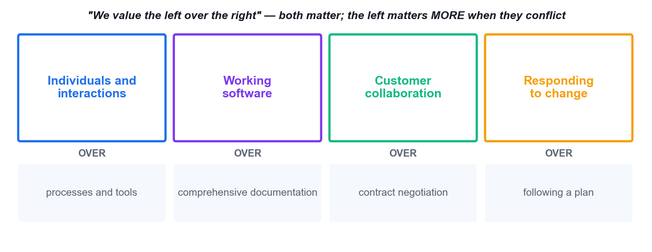
TOPIC 02 · K6 · THE FOUR VALUES
The Agile Manifesto — Four Values
agilemanifesto.org — 'while there is value in the items on the right, we value the items on the left more'.
Agile Project Management for Business · TGS-2023018967
© 2026 Tertiary Infotech Academy Pte Ltd
47

Slide 48
TOPIC 02 · WHAT EACH VALUE MEANS IN PRACTICE
Reading the Four Values Correctly
1
Individuals & interactions
2
Working software
3
Customer collaboration
4
Responding to change
Tools are necessary; they never rescue a team that will not talk. Problems are solved by people.
Deliver something that works. Keep documents barely sufficient, just in time, and for a stated reason.
Manage change rather than suppress it. Build a shared, written definition of 'done'.
Energy spent defending the original plan is energy taken from delivering value.
THE COMMON MISREADING
'We value the left over the right' does NOT mean the right is worthless. Agile teams still plan, still document, still contract — they just refuse to let those things outrank delivered value.
Agile Project Management for Business · TGS-2023018967
© 2026 Tertiary Infotech Academy Pte Ltd
48

Slide 49
TOPIC 02 · K6 · PRINCIPLES 1–6
The Twelve Principles — 1 to 6
1 · Satisfy the customer
Through early and continuous delivery of valuable work.
2 · Welcome change
Even late in development — harness change for competitive advantage.
1
2
3 · Deliver frequently
From a couple of weeks to a couple of months; prefer the shorter timescale.
4 · Work together daily
Business people and delivery people, throughout the project.
3
4
5 · Motivated individuals
Give them the environment and support they need, and trust them.
6 · Face-to-face conversation
The most efficient and effective way to convey information.
5
6
Agile Project Management for Business · TGS-2023018967
© 2026 Tertiary Infotech Academy Pte Ltd
49

Slide 50
TOPIC 02 · K6 · PRINCIPLES 7–12
The Twelve Principles — 7 to 12
7 · Working output measures progress
Not percent-complete of tasks, and not documents produced.
8 · Sustainable pace
Sponsors, developers and users maintain a constant pace indefinitely.
1
2
9 · Technical excellence
Continuous attention to quality and good design enhances agility.
10 · Simplicity
Maximising the work NOT done is essential.
3
4
11 · Self-organising teams
The best architectures, requirements and designs emerge from them.
12 · Reflect and adjust
At regular intervals, tune and adjust behaviour accordingly.
5
6
Agile Project Management for Business · TGS-2023018967
© 2026 Tertiary Infotech Academy Pte Ltd
50

Slide 51
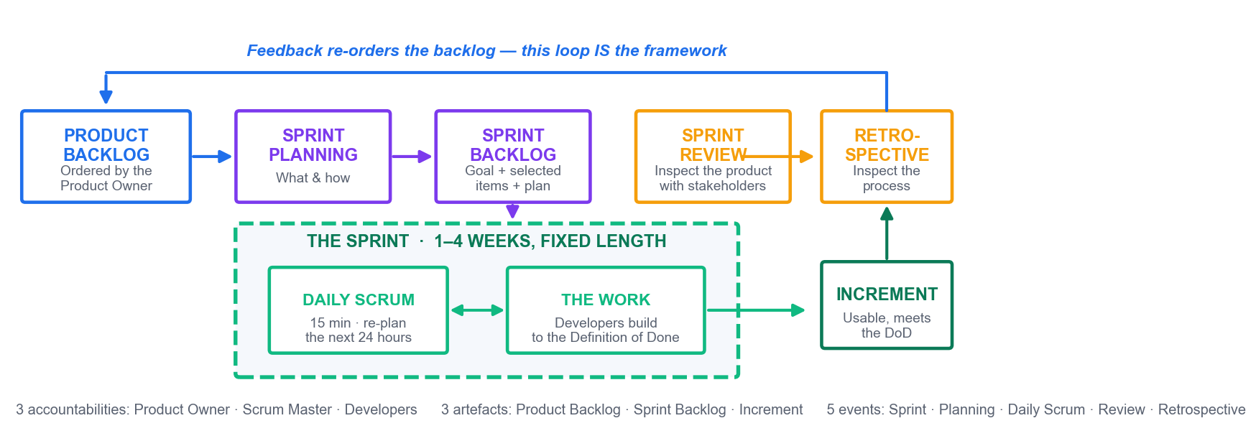
TOPIC 02 · K7 · SCRUM END TO END
The Scrum Framework
Scrum is built on empiricism: transparency, inspection and adaptation. The loop is the framework.
Agile Project Management for Business · TGS-2023018967
© 2026 Tertiary Infotech Academy Pte Ltd
51

Slide 52
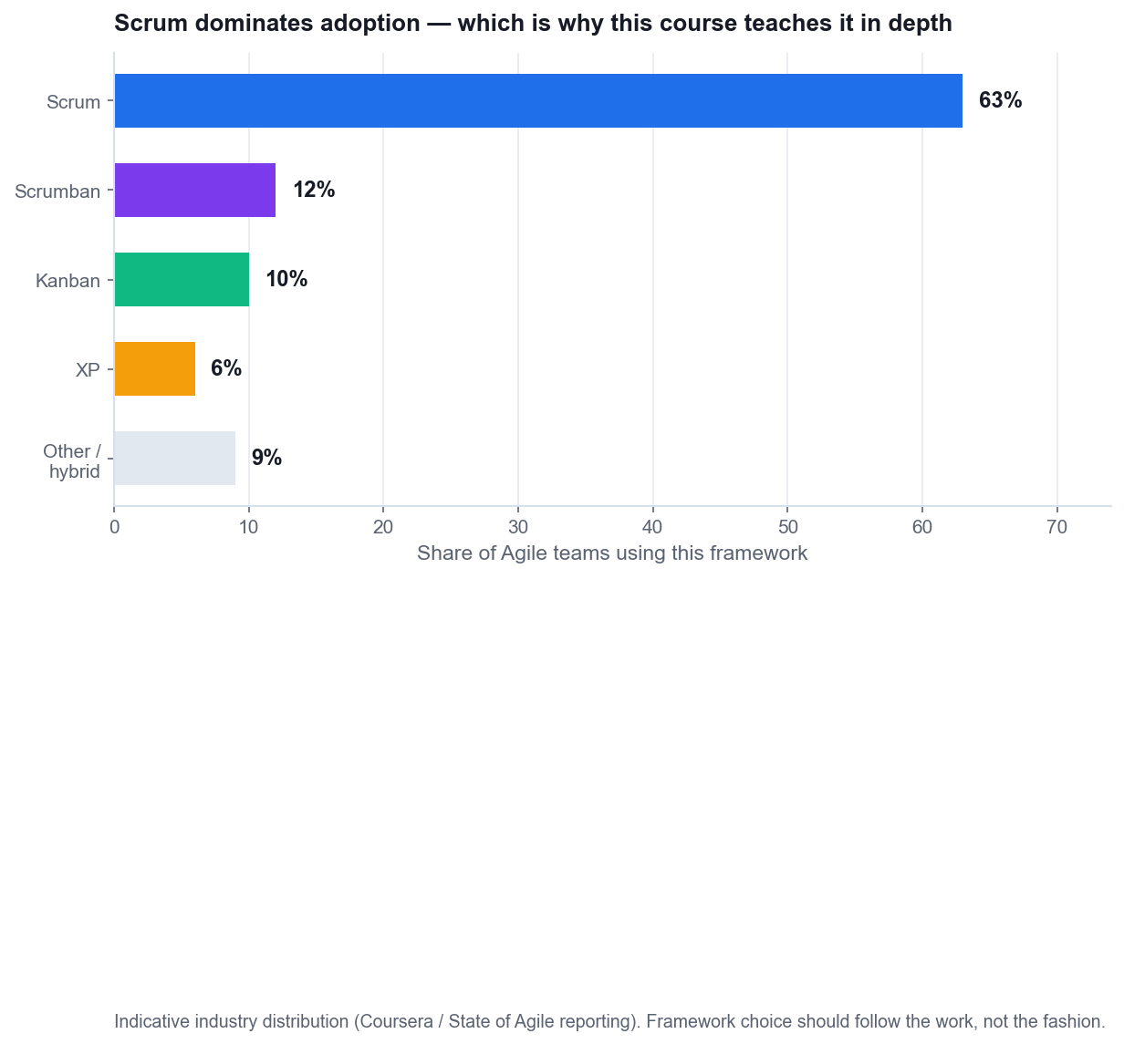
TOPIC 02 · FRAMEWORK CHOICE
Why We Teach Scrum in Depth
Scrum dominates adoption
Roughly 63% of Agile teams use Scrum, so it is the shared vocabulary.
It is prescriptive enough to learn
Fixed roles, artefacts and events give a new team something to follow.
It generalises
The same cadence works for marketing, operations and product teams.
Then tailor it
Shu-Ha-Ri: follow the framework first, adapt once you understand why.
Agile Project Management for Business · TGS-2023018967
© 2026 Tertiary Infotech Academy Pte Ltd
52

Slide 53
TOPIC 02 · WHO DOES WHAT
The Three Scrum Accountabilities
1
Product Owner
2
Scrum Master
3
Developers
Owns value and the ORDER of the product backlog. One person, not a committee. Accepts or rejects each increment.
Owns the process. A servant leader who removes impediments, coaches the team and shields it from interruption.
Own HOW the work is done and how much enters the sprint. Cross-functional, self-organising, collectively accountable.
THE FAILURE MODE
Almost every 'Scrum doesn't work here' story traces to a Product Owner who cannot decide, or a manager who overrules the sprint. You will map this yourself in Activity 4.
Agile Project Management for Business · TGS-2023018967
© 2026 Tertiary Infotech Academy Pte Ltd
53

Slide 54
TOPIC 02 · THE THREE ARTEFACTS
Scrum Artefacts and Their Commitments
Artefact
What it is
Its commitment
Product Backlog
The ordered list of everything known to be needed
The Product Goal
Sprint Backlog
The selected items plus the plan to deliver them
The Sprint Goal
Increment
A usable, integrated slice of the product
The Definition of Done
Each artefact carries a commitment. An artefact without its commitment becomes a list nobody trusts.
Agile Project Management for Business · TGS-2023018967
© 2026 Tertiary Infotech Academy Pte Ltd
54

Slide 55
TOPIC 02 · THE SPRINT CONTAINER
The Five Scrum Events
1
2
3
4
5
▶
▶
▶
▶
Sprint Planning
Daily Scrum
The Work
Sprint Review
Retrospective
what and how · up to 8h
15 min · re-plan the next 24h
build to the Definition of Done
inspect the product with stakeholders
inspect the process
All five sit inside the Sprint — a fixed-length container of 1–4 weeks. The length does not change sprint to sprint.
Agile Project Management for Business · TGS-2023018967
© 2026 Tertiary Infotech Academy Pte Ltd
55

Slide 56
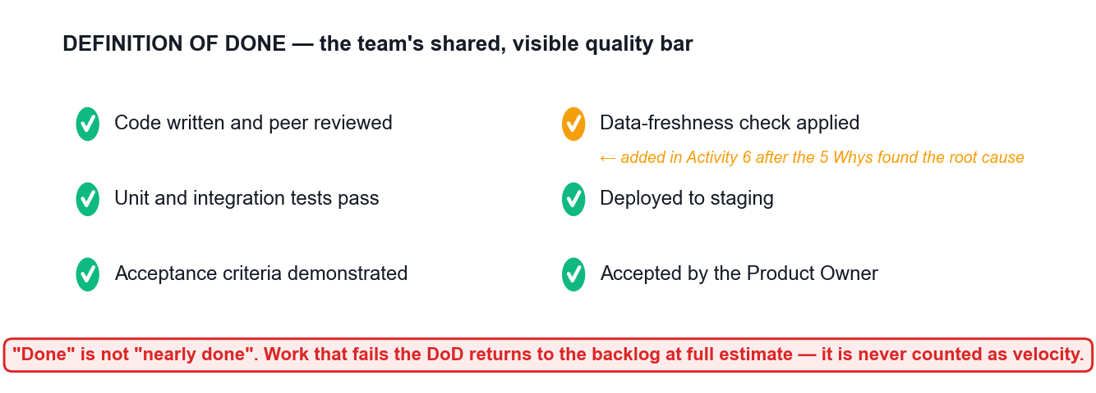
TOPIC 02 · THE QUALITY BAR
Definition of Done
The DoD is the team's shared quality bar. Without it, 'done' means something different to every person in the room.
Agile Project Management for Business · TGS-2023018967
© 2026 Tertiary Infotech Academy Pte Ltd
56

Slide 57
TOPIC 02 · K7 · LEAN
Lean — Seven Principles from Toyota
1
Eliminate waste
To maximise value, minimise everything that is not value.
2
Amplify learning
Communicate early and often; get feedback as soon as possible.
3
Decide as late as possible
Keep options open until the last responsible moment.
4
Deliver as fast as possible
Speed and quality are allies, not opposites.
5
Empower the team
Respect the team's superior knowledge of the technical steps.
6
Build quality in
Assure quality throughout, rather than inspecting it at the end.
7
Optimise the whole
The system is more than the sum of its parts — beware local optimisation.
8
Kaizen
Small, frequent, team-owned improvement, forever.
Agile Project Management for Business · TGS-2023018967
© 2026 Tertiary Infotech Academy Pte Ltd
57

Slide 58
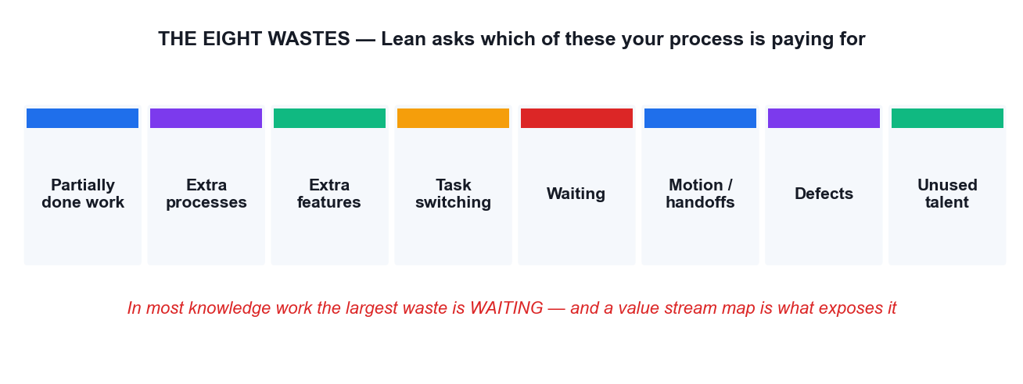
TOPIC 02 · WHAT LEAN ATTACKS
The Eight Wastes
In knowledge work the dominant waste is almost always WAITING — which is why value stream mapping is so effective.
Agile Project Management for Business · TGS-2023018967
© 2026 Tertiary Infotech Academy Pte Ltd
58

Slide 59
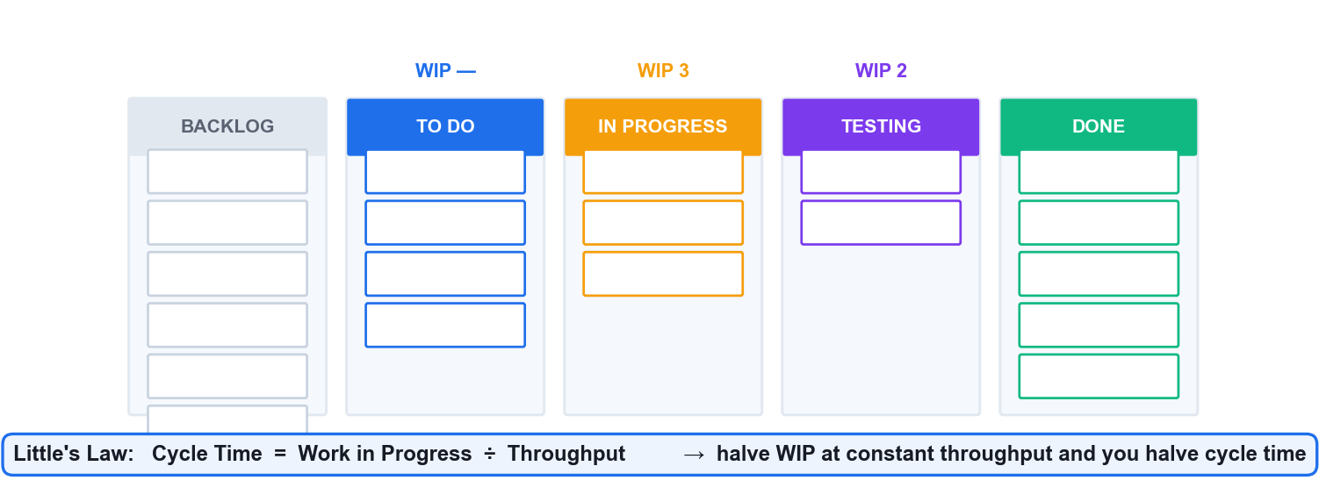
TOPIC 02 · K7 · KANBAN
Kanban — Visualise, Limit WIP, Manage Flow
Little's Law is the engine: limiting WIP is what actually makes delivery faster, not working harder.
Agile Project Management for Business · TGS-2023018967
© 2026 Tertiary Infotech Academy Pte Ltd
59

Slide 60
TOPIC 02 · HOW KANBAN WORKS
Kanban's Five Practices
1
Visualise the workflow
2
Limit work in progress
3
Manage flow
4
Make policies explicit
5
Improve collaboratively
Knowledge work is invisible until you put it on a board.
WIP limits surface bottlenecks instead of hiding them.
Track how work moves, and measure the effect of each change.
Write down what 'ready' and 'done' mean so the team can debate them.
Evolve the process experimentally, as a team.
THE COUNTER-INTUITIVE PART
Starting less work finishes more work. You will prove this to yourself in Activity 5 when the burndown flattens, and again in Activity 8 with the control chart.
Agile Project Management for Business · TGS-2023018967
© 2026 Tertiary Infotech Academy Pte Ltd
60

Slide 61
TOPIC 02 · K7 · FRAMEWORK SELECTION
Scrum vs Kanban vs Scrumban — Choosing
Dimension
Scrum
Kanban
Scrumban
Cadence
Fixed sprints, 1–4 weeks
Continuous flow
Cadence plus WIP limits
Commitment
A Sprint Goal per sprint
Pull when capacity frees
Goal, with flexible pull
Best for
Teams of 5–9 with a product goal
Support queues, high variability
Teams outgrowing strict Scrum
Roles
PO, SM, Developers
No prescribed roles
Usually keeps PO and SM
Key metric
Velocity, sprint burndown
Cycle time, throughput, CFD
Both sets
Pick by the shape of the work, never by fashion. A support team forced into sprints will fight the framework every week.
Agile Project Management for Business · TGS-2023018967
© 2026 Tertiary Infotech Academy Pte Ltd
61

Slide 62
TOPIC 02 · K7 · XP
Extreme Programming (XP)
1
Five values
Simplicity, communication, feedback, courage and respect.
2
Test-driven development
Write the test first; the code passes it once written correctly.
3
Pair programming
Two people, real-time review, and knowledge spread through the team.
4
Continuous integration
Bring code together constantly so incompatibility surfaces early.
5
Refactoring
Remove redundancy and rejuvenate design continuously, not 'later'.
6
Collective ownership
Anyone can improve any part; less risk when someone leaves.
7
Small releases
Frequent small releases keep progress visible to the customer.
8
Sustainable pace
Repeated long hours are unsustainable and counterproductive.
Agile Project Management for Business · TGS-2023018967
© 2026 Tertiary Infotech Academy Pte Ltd
62

Slide 63
TOPIC 02 · K7 · THE WIDER LANDSCAPE
Other Methods Worth Knowing
1
DSDM / AgilePM
2
Feature-Driven Development
3
Crystal
4
SAFe / LeSS
The APM-endorsed framework: feasibility, foundations, evolutionary development, deployment. Strong on governance.
Model first, build a feature list, then plan and build by feature.
A family of methods sized by team and criticality, colour-coded.
Scaling frameworks for many teams on one product or portfolio.
FOR SINGAPORE PRACTITIONERS
DSDM/AgilePM is the framework APM (UK) endorses and the one most often referenced in regulated and public-sector delivery — worth knowing by name in a tender conversation.
Agile Project Management for Business · TGS-2023018967
© 2026 Tertiary Infotech Academy Pte Ltd
63

Slide 64
TOPIC 02 · K4 · PREPARING FOR RESISTANCE
Finding Agile Support — Address Each Fear Directly (K4)
Senior management & sponsors
Fear: the risk of visible failure. Answer: incremental funding lets you stop early and cheaply.
Middle managers
Fear: loss of control. Answer: they gain real progress data instead of percent-complete estimates.
1
2
The project team
Fear: exposure and surveillance. Answer: the board shows the WORK, not individual performance.
Users & customers
Fear: losing promised features. Answer: they get the highest-value features sooner, and a say each sprint.
3
4
Finance & PMO
Fear: no fixed scope to audit. Answer: fixed cadence, fixed cost, auditable increments.
Quality & compliance
Fear: reduced rigour. Answer: the Definition of Done makes the quality bar explicit and testable.
5
6
Agile Project Management for Business · TGS-2023018967
© 2026 Tertiary Infotech Academy Pte Ltd
64

Slide 65
TOPIC 02 · K4 · METHODOLOGIES AND PRACTICES
Change Management — Making the Adoption Stick (K4)
1
Start with a willing pilot
2
Make the wins visible
3
Evolutionary, not revolutionary
4
Train, coach, then withdraw
Volunteers, on a real project that matters, with visible sponsorship.
Publish the increment and the metrics. Evidence beats evangelism.
APM's guidance: change the culture in steps the organisation can absorb.
Coach the team through 2–3 sprints, then let it own the process.
THE HONEST WARNING
Never sell Agile as a way to get more output for less money. It buys responsiveness, earlier value and lower risk of building the wrong thing — not free capacity.
Agile Project Management for Business · TGS-2023018967
© 2026 Tertiary Infotech Academy Pte Ltd
65

Slide 66
WHAT YOU'LL DO
Hands-On Activities — Agile Essentials
1
Activity 3 · Build the Product Backlog and Run Sprint 1 Planning
2
Activity 4 · Clarify Agile Role Accountability with a RACI Matrix
Tool: Scrum Board 60 minutes · LO2
Tool: RACI Matrix 45 minutes · LO2
ALL ON ONE CASE
Every activity in this topic advances the same HarbourFront CustomerConnect case, so the artefacts you build compound.
Agile Project Management for Business · TGS-2023018967
© 2026 Tertiary Infotech Academy Pte Ltd
66

Slide 67
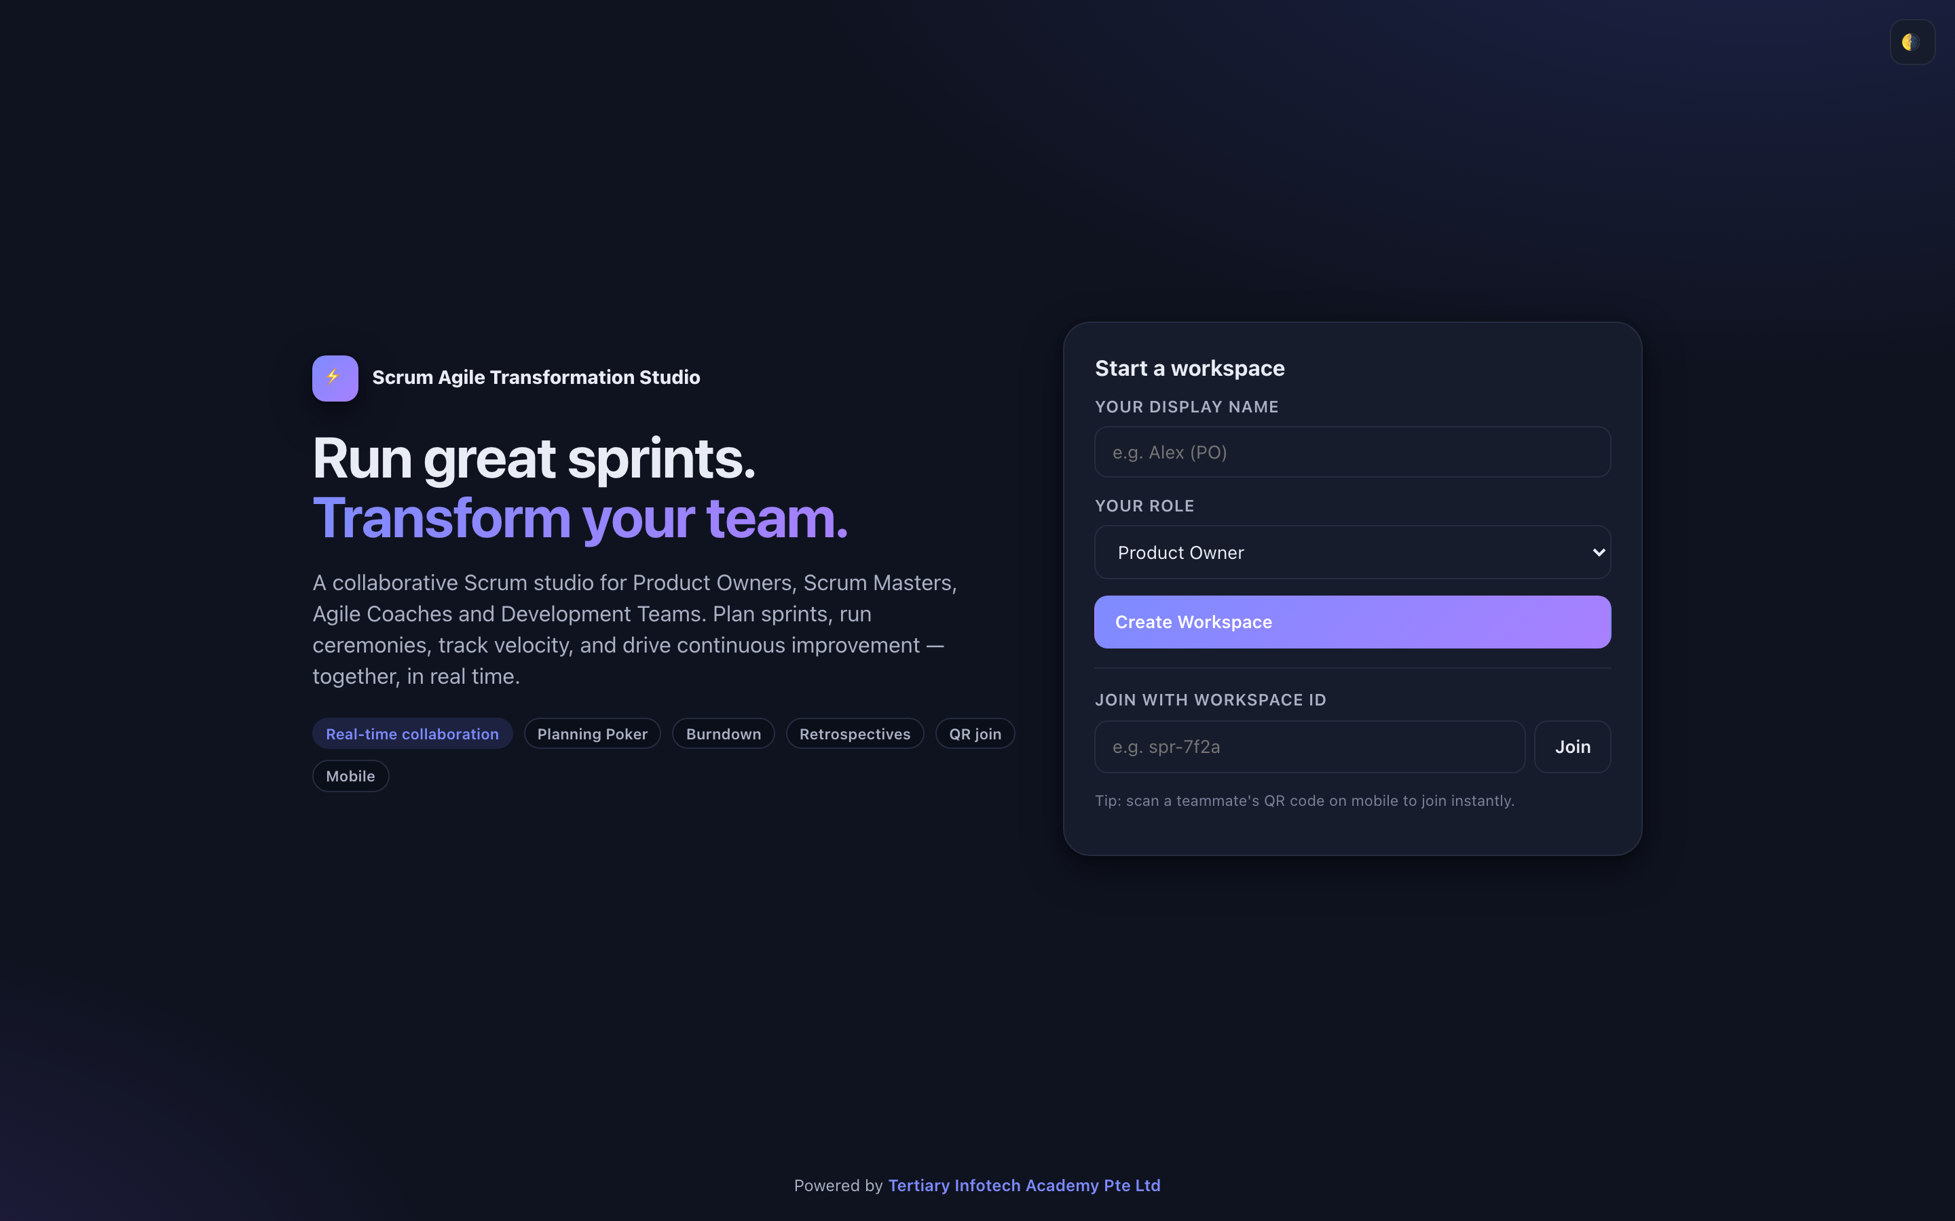
ACTIVITY 3 · TOOL
The Tool — Scrum Board
Open it in your browser
https://alfredang.github.io/scrum/
No install, no login
It runs in the browser. Work on one shared screen as a team.
Build the artefact
The deliverable named on the next slide.
Export it
Screenshot or export into your Activity worksheet.
Activity 3 · 60 minutes · full step-by-step: Learner Guide, Activity 3
Agile Project Management for Business · TGS-2023018967
© 2026 Tertiary Infotech Academy Pte Ltd
67

Slide 68
TOPIC 02 · HANDS-ON ACTIVITY
ACTIVITY 3 · 60 MIN
Build the Product Backlog and Run Sprint 1 Planning
THE SITUATION
HarbourFront's committee has approved a restart: 6 sprints of 2 weeks, one team of 7 people, and a hard demonstration to the top 5 customers in 12 weeks. Nothing from the old 96-page document is carried over unexamined. You are the team, with your trainer as Product Owner. Sprint 1 planning starts now.
WHAT YOU'LL DO
YOU'LL PRODUCE
DONE WHEN
Your team writes user stories from the Activity 1 customer insight, applies INVEST, estimates with planning poker using the Fibonacci sequence, orders the backlog with MoSCoW, then loads Sprint 1 to a capacity of 20 story points and writes a single sprint goal. You use the Scrum tool to hold the backlog and the sprint board.
A product backlog of at least 12 estimated user stories in priority order, a Sprint 1 backlog of about 20 points, one written sprint goal, and a Definition of Done agreed by the whole team.
Sprint 1 holds about 20 points, every story in it serves the one written sprint goal, no story exceeds 8 points, every story has Given/When/Then acceptance criteria, and the Definition of Done is visible to the whole team. A sprint whose stories serve four unrelated goals is a task list, not a sprint.
ACT 3
Tool: Scrum Board — https://alfredang.github.io/scrum/
LO 2 · Implement Agile practices by converting business needs into an ordered product backlog and a committed sprint backlog with a sprint goal (K6, K7, A3). · Full step-by-step: Learner Guide, Activity 3
Agile Project Management for Business · TGS-2023018967
© 2026 Tertiary Infotech Academy Pte Ltd
68

Slide 69
TOPIC 02 · ACTIVITY 3 DEBRIEF
Debrief — Activity 3: What It Proves
The sprint goal is the single most skipped artefact and the one that makes the sprint reviewable.
1
Splitting by workflow step keeps every slice demonstrable; splitting by technical layer produces a sprint with nothing to show.
2
This is A3 in practice: implementing Agile practices to reduce waste — an ordered backlog stops the team building the 62% nobody used.
3
SUCCESS CRITERION
Sprint 1 holds about 20 points, every story in it serves the one written sprint goal, no story exceeds 8 points, every story has Given/When/Then acceptance criteria, and the Definition of Done is visible to the whole team. A sprint whose stories serve four unrelated goals is a task list, not a sprint.
Agile Project Management for Business · TGS-2023018967
© 2026 Tertiary Infotech Academy Pte Ltd
69

Slide 70
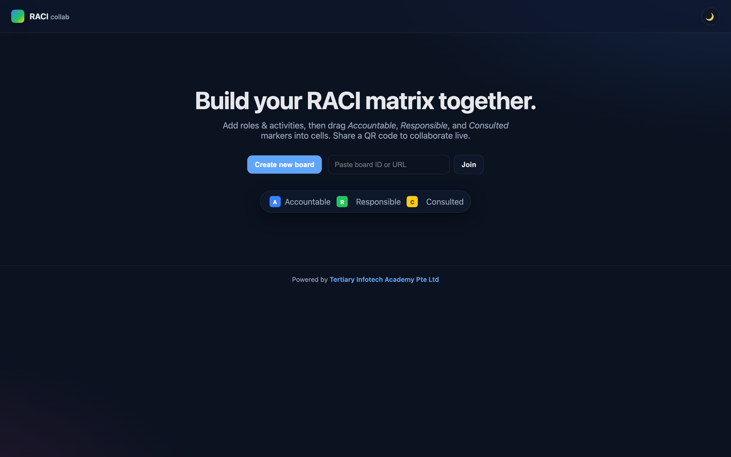
ACTIVITY 4 · TOOL
The Tool — RACI Matrix
Open it in your browser
https://alfredang.github.io/raci/
No install, no login
It runs in the browser. Work on one shared screen as a team.
Build the artefact
The deliverable named on the next slide.
Export it
Screenshot or export into your Activity worksheet.
Activity 4 · 45 minutes · full step-by-step: Learner Guide, Activity 4
Agile Project Management for Business · TGS-2023018967
© 2026 Tertiary Infotech Academy Pte Ltd
70

Slide 71
TOPIC 02 · HANDS-ON ACTIVITY
ACTIVITY 4 · 45 MIN
Clarify Agile Role Accountability with a RACI Matrix
THE SITUATION
Two weeks into the restart, CustomerConnect has stalled in a familiar way. The old programme director is still approving every story change. The Scrum Master has been asked to produce a weekly percent-complete report. Two developers have escalated that they receive conflicting priorities from the Product Owner and from the operations manager. Nobody is behaving badly — the accountabilities were never made explicit.
WHAT YOU'LL DO
YOU'LL PRODUCE
DONE WHEN
Your team uses the RACI tool to map 12 real project decisions and activities against the five roles in play. You then find the anti-patterns — activities with two Accountables, activities with none, and roles consulted on everything — and produce the corrected matrix that resolves the conflicting-priorities escalation.
A completed RACI matrix covering 12 activities across 5 roles, a list of the anti-patterns found, and the corrected matrix with the specific change that resolves the developers' escalation.
Every one of the 12 rows has exactly one A. No role is C on more than about half the rows. The developers' conflicting-priorities escalation is traceable to a specific duplicate A in your first draft, and your corrected matrix removes it.
ACT 4
Tool: RACI Matrix — https://alfredang.github.io/raci/
LO 2 · Share information across teams and organise work in alignment with priorities by making Agile role accountability explicit (K5, A1, A2). · Full step-by-step: Learner Guide, Activity 4
Agile Project Management for Business · TGS-2023018967
© 2026 Tertiary Infotech Academy Pte Ltd
71

Slide 72
TOPIC 02 · ACTIVITY 4 DEBRIEF
Debrief — Activity 4: What It Proves
Most Agile 'transformation failures' are accountability failures wearing an Agile label.
1
The single A rule is what makes a Product Owner viable. Two Accountables for backlog order guarantees the escalation you just resolved.
2
This is A1 and A2 in practice: sharing information across teams to bridge operational barriers, and organising work in line with actual priorities.
3
SUCCESS CRITERION
Every one of the 12 rows has exactly one A. No role is C on more than about half the rows. The developers' conflicting-priorities escalation is traceable to a specific duplicate A in your first draft, and your corrected matrix removes it.
Agile Project Management for Business · TGS-2023018967
© 2026 Tertiary Infotech Academy Pte Ltd
72

Slide 73
TOPIC RECAP · LO2 · K4, K6, K7, A1, A3
Recap — Agile Essentials
Activity 3 · Build the Product Backlog and Run Sprint 1 Planning
Implement Agile practices by converting business needs into an ordered product backlog and a committed sprint backlog with a sprint goal (K6, K7, A3).
1
Activity 4 · Clarify Agile Role Accountability with a RACI Matrix
Share information across teams and organise work in alignment with priorities by making Agile role accountability explicit (K5, A1, A2).
2
Agile Project Management for Business · TGS-2023018967
© 2026 Tertiary Infotech Academy Pte Ltd
73

Slide 74
End of Day 1
See you at 09:30 tomorrow · Digital attendance (AM)

Slide 75
03
TOPIC 03
Agile Project Execution and Tracking
Team building & vision · User stories & estimation · Execution · Metrics · Continuous improvement · LO3 · K5, A4, A6, A7
Agile Project Management for Business · TGS-2023018967
© 2026 Tertiary Infotech Academy Pte Ltd
75

Slide 76
TOPIC 03 · MAKING IT RUN
A team, a vision, a rhythm, and honest numbers.
Topic 3 is where Agile stops being a philosophy and becomes a week of work: who is on the team, what they are aiming at, how the work flows, and what the metrics actually tell you.
Agile Project Management for Business · TGS-2023018967
© 2026 Tertiary Infotech Academy Pte Ltd
76

Slide 77
TOPIC 03 · K5 · WHAT A GOOD AGILE TEAM LOOKS LIKE
Team Composition and Formation Models (K5)
1
Cross-functional
2
Self-organising
3
Fewer than ~12
Every skill needed to get to Done sits inside the team.
The team decides how to do the work, not just what to do.
Communication paths grow faster than headcount. Small teams stay coherent.
4
Stable membership
5
Generalising specialists
6
Co-located or deliberately connected
Velocity is meaningless if the team changes every sprint.
Deep in one skill, capable across several — this removes queues.
Osmotic communication, or tooling that replaces it on purpose.
THE BOTTLENECK YOU WILL MEET
One specialist per skill guarantees queues — work piles up behind the only person who can do it. You will see exactly this as the Testing bottleneck in Activity 8.
Agile Project Management for Business · TGS-2023018967
© 2026 Tertiary Infotech Academy Pte Ltd
77

Slide 78
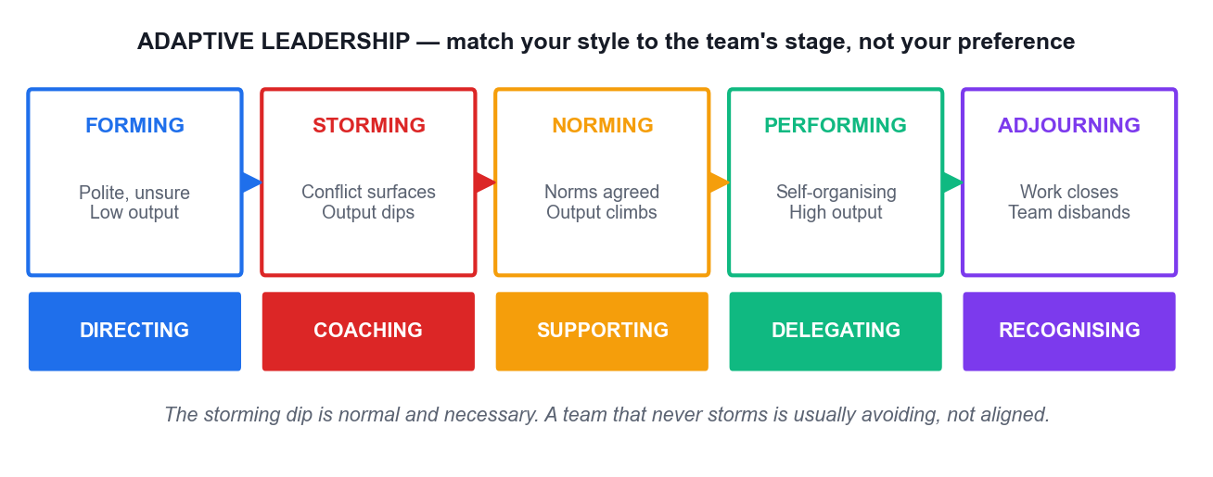
TOPIC 03 · K5 · TEAM DEVELOPMENT
Tuckman's Stages and Adaptive Leadership
Match your leadership style to the team's stage. Delegating to a forming team fails; directing a performing team insults it.
Agile Project Management for Business · TGS-2023018967
© 2026 Tertiary Infotech Academy Pte Ltd
78

Slide 79
TOPIC 03 · LEADING WITHOUT AUTHORITY
Servant Leadership — What the Agile Leader Actually Does
Shield the team
Absorb interruptions so the team can hold a sustainable focus.
Remove impediments
Own the blockers the team cannot clear itself, and clear them fast.
1
2
Re-communicate the vision
People forget the goal under delivery pressure. Repeat it.
Tap intrinsic motivation
Autonomy, mastery and purpose outperform instruction.
3
4
Model the behaviour
Honesty, competence and forward-looking judgement, visibly.
Create safety to experiment
A team that cannot fail safely will not tell you the truth.
5
6
Agile Project Management for Business · TGS-2023018967
© 2026 Tertiary Infotech Academy Pte Ltd
79

Slide 80
TOPIC 03 · GETTING ONE PICTURE IN EVERY HEAD
Setting the Shared Vision
Agile charter
Who, what, why, when, where and how — high-level, and authority to proceed.
Product vision statement
One paragraph any team member can repeat from memory.
1
2
Definition of Done
The shared, testable meaning of 'finished'.
Personas
Grounded, goal-oriented descriptions of the real users.
3
4
Wireframes & prototypes
Low-fidelity artefacts that make 'done' visible before it is built.
Journey and story maps
The whole experience, so the team can see what each slice contributes.
5
6
Agile Project Management for Business · TGS-2023018967
© 2026 Tertiary Infotech Academy Pte Ltd
80

Slide 81
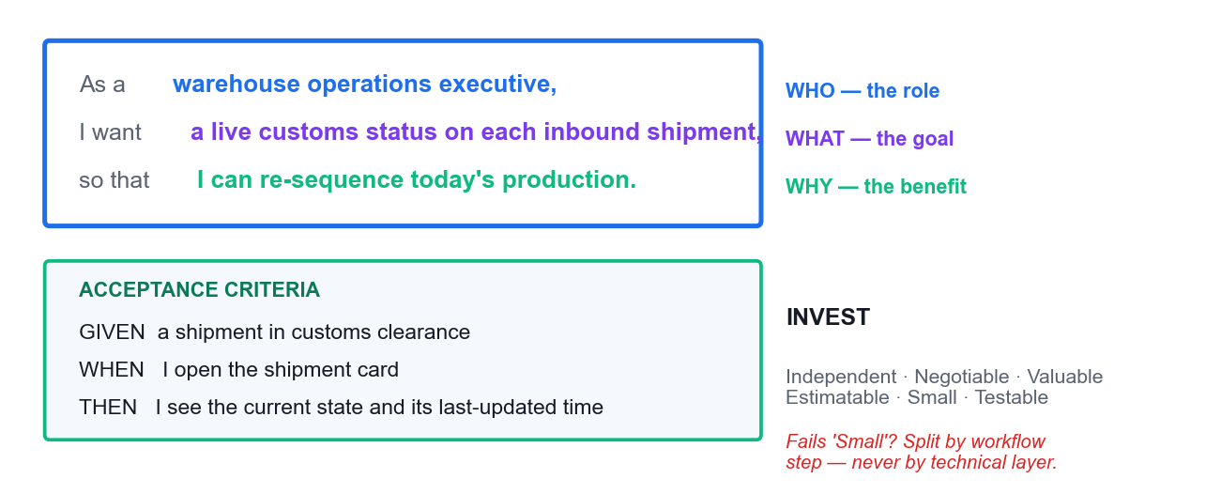
TOPIC 03 · REQUIREMENTS AS STORIES
The Anatomy of a User Story
Role, goal, benefit — plus testable acceptance criteria. This exact story is the one you write in Activity 3.
Agile Project Management for Business · TGS-2023018967
© 2026 Tertiary Infotech Academy Pte Ltd
81

Slide 82
TOPIC 03 · WRITING STORIES THAT WORK
The Three Cs and INVEST
1
Card
2
Conversation
3
Confirmation
4
INVEST
The story is a placeholder, deliberately too small to hold the full requirement.
The detail is developed by talking, not by writing a longer document.
Acceptance criteria state how you will know it is done.
Independent · Negotiable · Valuable · Estimatable · Small · Testable.
THE SPLIT RULE
A story too large for one sprint must be split by WORKFLOW STEP or by DATA TYPE — never by technical layer. Splitting into 'the database part' and 'the UI part' produces a sprint with nothing to demonstrate.
Agile Project Management for Business · TGS-2023018967
© 2026 Tertiary Infotech Academy Pte Ltd
82

Slide 83
TOPIC 03 · ORDERING THE BACKLOG
Prioritisation Techniques
MoSCoW
Must / Should / Could / Won't have this time. Used in Activity 3.
Dot voting
Each person distributes a fixed number of dots across the options.
1
2
100-point method
Each stakeholder allocates 100 points, forcing real trade-offs.
Monopoly money
Equal 'funds' spent on what each stakeholder values most.
3
4
Kano analysis
Separates delighters, satisfiers, must-haves and indifferent features.
Weighted shortest job first
Value divided by effort — highest ratio goes first.
5
6
Agile Project Management for Business · TGS-2023018967
© 2026 Tertiary Infotech Academy Pte Ltd
83

Slide 84
TOPIC 03 · AGILE ESTIMATION
Estimation — Why Relative Beats Absolute
1
Humans estimate badly in absolutes
2
Story points
3
Planning poker
4
Affinity & T-shirt sizing
We are poor at hours, and consistently good at comparisons.
Complexity, effort and risk in one relative number.
Simultaneous reveal on a Fibonacci scale defeats anchoring and the loudest voice.
Fast grouping for large backlogs before detailed estimation.
THE 13-POINT RULE
A story estimated at 13 or 21 points is not a big story — it is a story the team does not yet understand. Split it before it enters a sprint.
Agile Project Management for Business · TGS-2023018967
© 2026 Tertiary Infotech Academy Pte Ltd
84

Slide 85
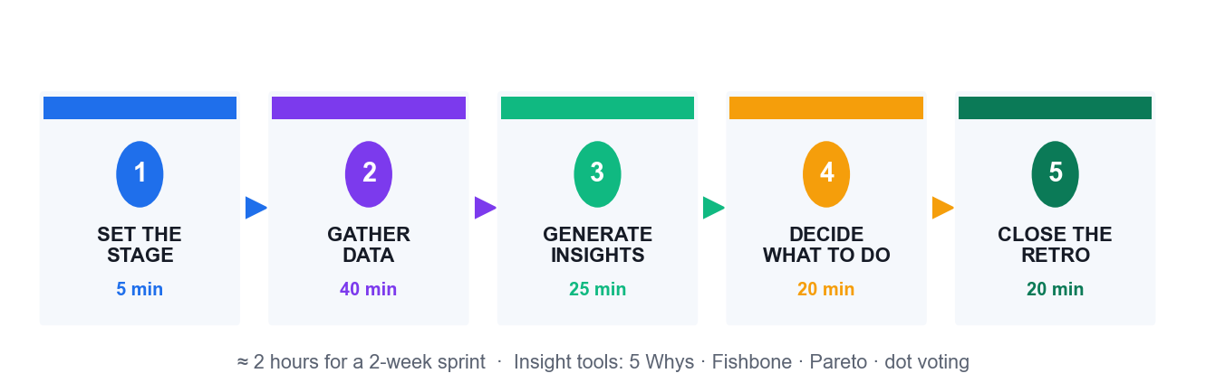
TOPIC 03 · THE DISCIPLINE OF THE TIMEBOX
Timeboxing and Parkinson's Law
Daily Scrum · 15 minutes
Long enough to re-plan a day, short enough to stay standing.
Retrospective · ~2 hours
For a two-week sprint, in five deliberate stages.
Sprint · 1–4 weeks
Fixed length, so velocity means something across sprints.
Parkinson's Law
Work expands to fill the time available — so the box does the managing.
Agile Project Management for Business · TGS-2023018967
© 2026 Tertiary Infotech Academy Pte Ltd
85

Slide 86
TOPIC 03 · A4 · MEASURING PROGRESS
Five metrics tell you everything you need to know.
Sprint burndown for the sprint. Release burndown for the release. Velocity for the forecast. Control chart for cycle time. Cumulative flow diagram for the bottleneck.
Agile Project Management for Business · TGS-2023018967
© 2026 Tertiary Infotech Academy Pte Ltd
86

Slide 87
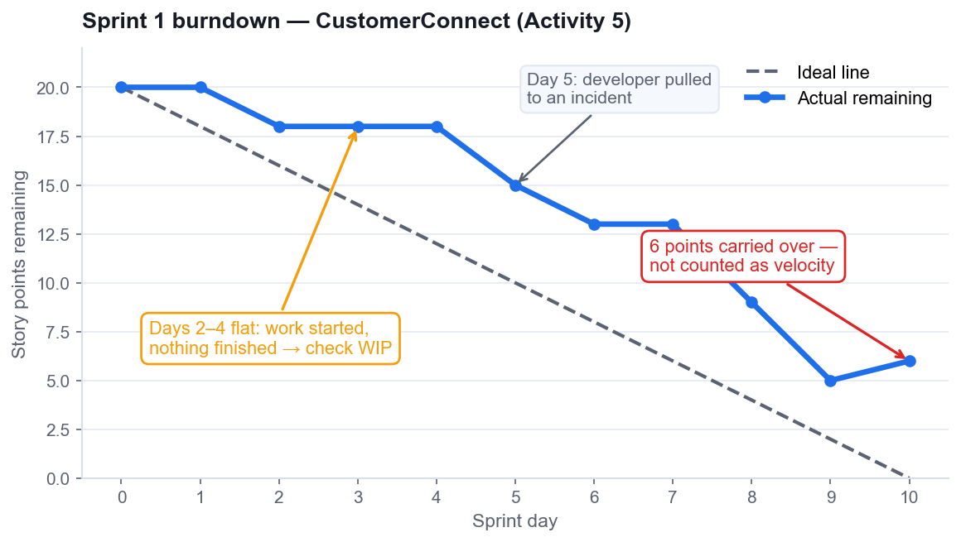
TOPIC 03 · A4 · TRACKING THE SPRINT
Metric 1 — Sprint Burndown
What it shows
Points remaining inside one sprint, day by day, against the ideal line.
Read the flat line
Flat means work is STARTED but not FINISHED — check WIP, not effort.
Read the cliff
A late vertical drop means work was integrated at the end. That is a risk, not a triumph.
Carryover
Unfinished work returns to the backlog at full estimate. It is never partial velocity.
Agile Project Management for Business · TGS-2023018967
© 2026 Tertiary Infotech Academy Pte Ltd
87

Slide 88
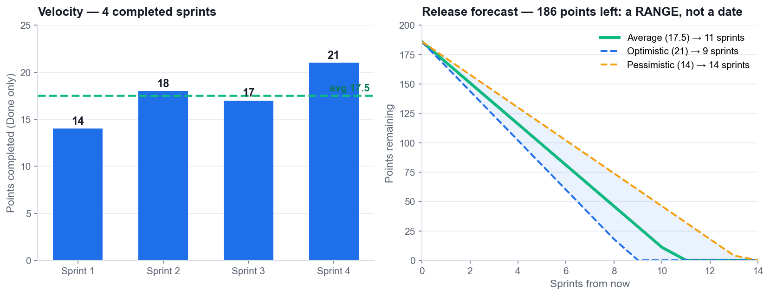
TOPIC 03 · A4 · FORECASTING HONESTLY
Metrics 2 & 3 — Velocity and the Release Forecast
Velocity
Average points DONE per sprint. A forecasting input, never a performance target.
Forecast as a range
Slowest, average and fastest sprints give a cone, not a date.
State the assumptions
Stable team, stable backlog, same estimation scale, no lost sprints.
The anti-pattern
Reward velocity and you get estimate inflation — the forecast then breaks.
Agile Project Management for Business · TGS-2023018967
© 2026 Tertiary Infotech Academy Pte Ltd
88

Slide 89
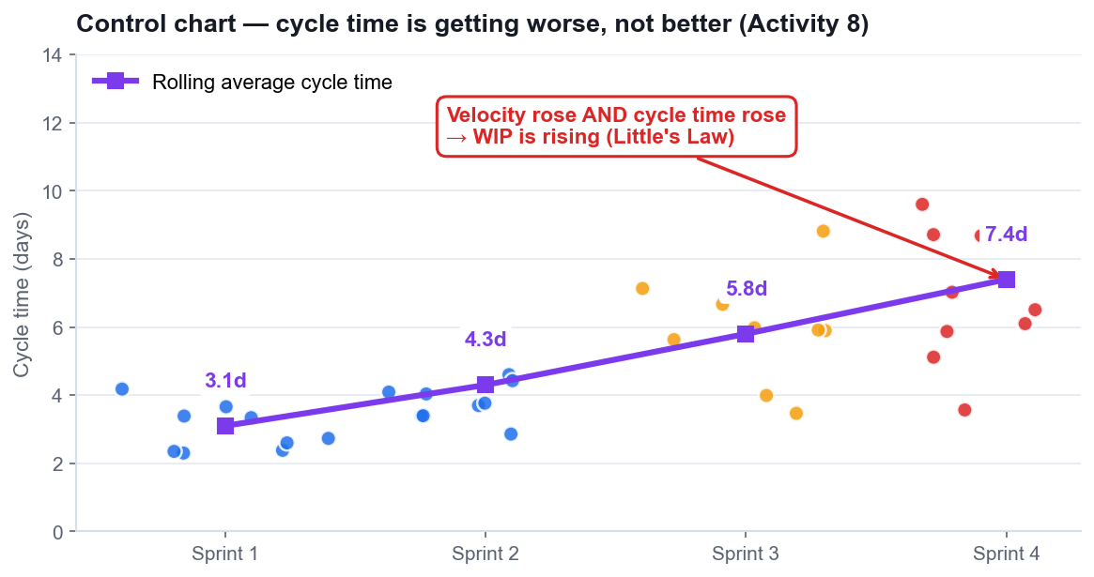
TOPIC 03 · A4 · CYCLE TIME
Metric 4 — The Control Chart
What it shows
Cycle time and lead time per work item, and the trend across sprints.
Lead vs cycle time
Lead time is the customer's whole wait; cycle time is the team's active portion.
The warning sign
Velocity rising AND cycle time rising means WIP is rising.
What to do
Lower the WIP limit at the constraint. Stop starting, start finishing.
Agile Project Management for Business · TGS-2023018967
© 2026 Tertiary Infotech Academy Pte Ltd
89

Slide 90
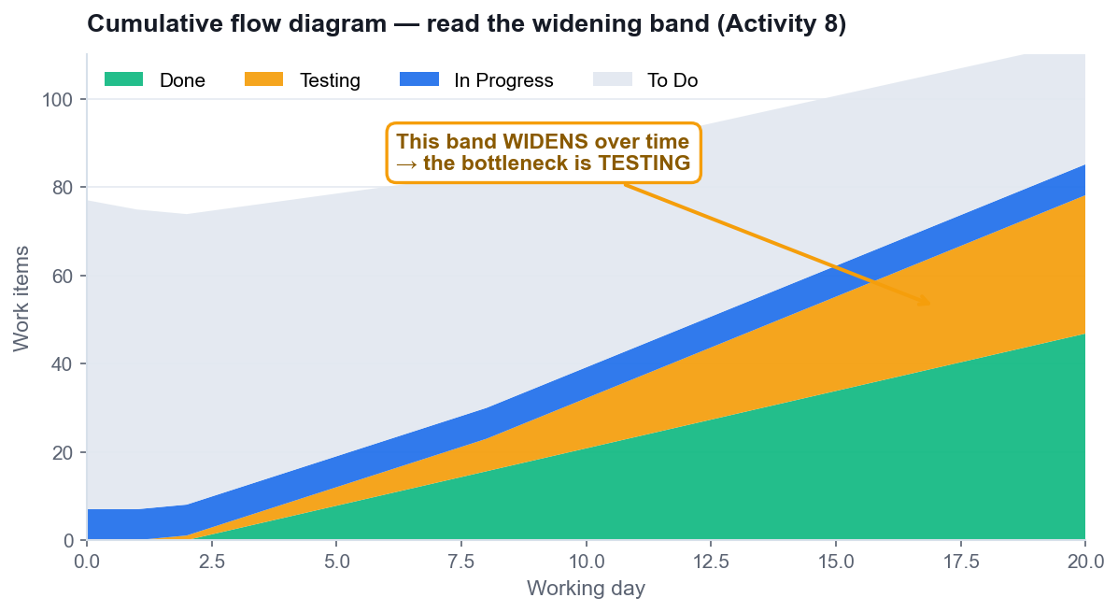
TOPIC 03 · A4 · FINDING THE BOTTLENECK
Metric 5 — The Cumulative Flow Diagram
What it shows
The count of items in each status over time, as stacked bands.
Read the widening band
A band widening vertically is a bottleneck at THAT status.
Read the flat Done band
Flat 'Done' means nothing is being completed, whatever the team is busy with.
Act on the constraint
Move capacity to the widening column — not to the busiest-looking one.
Agile Project Management for Business · TGS-2023018967
© 2026 Tertiary Infotech Academy Pte Ltd
90

Slide 91
TOPIC 03 · CYCLE TIME = WIP ÷ THROUGHPUT
Little's Law — Why Limiting WIP Speeds Delivery
Scenario
WIP
Throughput
Cycle time
Team starts everything
30 items
5 items/week
6 weeks
Team halves WIP
15 items
5 items/week
3 weeks
Team quarters WIP
8 items
5 items/week
1.6 weeks
Throughput did not change in any row. Only WIP changed — and cycle time fell with it. This is arithmetic, not opinion.
Agile Project Management for Business · TGS-2023018967
© 2026 Tertiary Infotech Academy Pte Ltd
91

Slide 92
TOPIC 03 · A6 · CONTINUOUS IMPROVEMENT
The Retrospective in Five Stages
The retrospective is the engine of improvement. Without an owned, funded action, it is just a feelings meeting.
Agile Project Management for Business · TGS-2023018967
© 2026 Tertiary Infotech Academy Pte Ltd
92

Slide 93
TOPIC 03 · A6 · DIAGNOSIS BEFORE ACTION
Root-Cause Tools — Use Them Together
1
5 Whys
2
Fishbone
3
Pareto
4
PDCA / Kaizen
Drills ONE causal chain to a process cause you can change. Activity 6.
Spreads causes across categories to see the whole problem. Activity 2.
Shows which few causes carry most of the pain. Activity 7.
Plan-Do-Check-Act: the loop that carries the fix into the next sprint.
THE SEQUENCE THAT WORKS
Fishbone to see the whole space, Pareto to pick the few that matter, 5 Whys to reach the changeable cause, then one SMART action with an owner and points in the next sprint.
Agile Project Management for Business · TGS-2023018967
© 2026 Tertiary Infotech Academy Pte Ltd
93

Slide 94
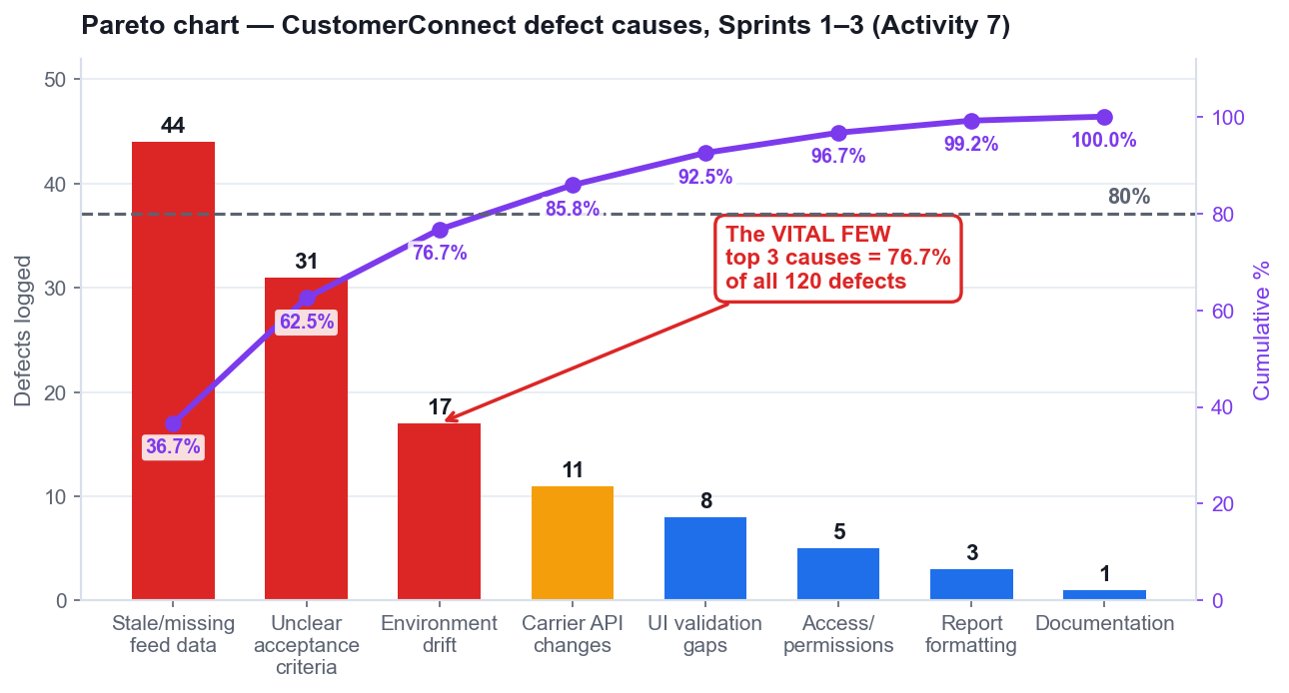
TOPIC 03 · A3 · PRIORITISING THE FIX
Pareto — Which Few Causes Carry Most of the Pain
The 80/20 pattern
A small number of causes generate most of the defects — reliably, across domains.
Always sort descending
An unsorted Pareto chart cannot be read. The cumulative line depends on the order.
Find the crossing point
Read where the cumulative line crosses 80% — those are the vital few.
Decide, don't admire
The chart's purpose is to justify what you will NOT fix this sprint.
The real CustomerConnect defect data you will analyse in Activity 7 — 120 defects across 8 causes.
Agile Project Management for Business · TGS-2023018967
© 2026 Tertiary Infotech Academy Pte Ltd
94

Slide 95
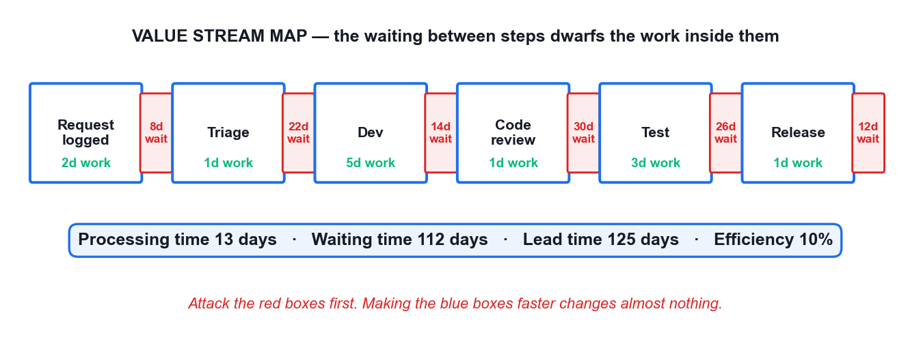
TOPIC 03 · A3 · REDUCING WASTE
Value Stream Mapping — Where the Time Actually Goes
13 days of work inside 125 days of lead time — 10% efficiency. The opportunity is in the waiting, not the working.
Agile Project Management for Business · TGS-2023018967
© 2026 Tertiary Infotech Academy Pte Ltd
95

Slide 96
TOPIC 03 · MANAGING UNCERTAINTY
Risk as Anti-Value
Risk is negative value
It erodes or removes value, so it belongs in the same conversation as value.
Risk-adjusted backlog
High-risk, high-value items are pulled earlier to retire uncertainty.
1
2
Expected monetary value
Probability × impact, so risks can be compared honestly.
Risk burndown chart
Tracks total exposure falling sprint by sprint.
3
4
Spikes
A timeboxed investigation to reduce a specific technical or risk unknown.
Schedule risk work as real items
A risk register nobody funds changes nothing.
5
6
Agile Project Management for Business · TGS-2023018967
© 2026 Tertiary Infotech Academy Pte Ltd
96

Slide 97
TOPIC 03 · A7 · TAKING OWNERSHIP
Technical Debt and Ownership (A7)
1
Debt compounds
2
Fund refactoring inside the sprint
3
Collective commitment
4
Raise impediments same-day
Work skipped to go faster makes every later sprint slower.
'Later' never arrives on its own.
The team commits to the Sprint Goal together, then each member pulls their own work.
Surfacing a blocker on day 9 is the failure — not the blocker itself.
WHAT ACCOUNTABILITY LOOKS LIKE
An honest board, a same-day impediment, and a 'Done' that means Done. Every metric in this topic depends on those three behaviours.
Agile Project Management for Business · TGS-2023018967
© 2026 Tertiary Infotech Academy Pte Ltd
97

Slide 98
WHAT YOU'LL DO
Hands-On Activities — Agile Project Execution and Tracking
1
Activity 5 · Execute Sprint 1 and Track It on the Scrum Board
2
Activity 6 · Run the Sprint Retrospective with 5 Whys Root-Cause Analysis
Tool: Scrum Board 60 minutes · LO3
Tool: 5 Whys 45 minutes · LO3
3
Activity 7 · Prioritise Defect Causes with a Pareto Chart
4
Activity 8 · Forecast the Release from Velocity and Read the Agile Metrics
Tool: Pareto Chart 45 minutes · LO3
Tool: Scrum Board 45 minutes · LO3
ALL ON ONE CASE
Every activity in this topic advances the same HarbourFront CustomerConnect case, so the artefacts you build compound.
Agile Project Management for Business · TGS-2023018967
© 2026 Tertiary Infotech Academy Pte Ltd
98

Slide 99
ACTIVITY 5 · TOOL
The Tool — Scrum Board
Open it in your browser
https://alfredang.github.io/scrum/
No install, no login
It runs in the browser. Work on one shared screen as a team.
Build the artefact
The deliverable named on the next slide.
Export it
Screenshot or export into your Activity worksheet.
Activity 5 · 60 minutes · full step-by-step: Learner Guide, Activity 5
Agile Project Management for Business · TGS-2023018967
© 2026 Tertiary Infotech Academy Pte Ltd
99

Slide 100
TOPIC 03 · HANDS-ON ACTIVITY
ACTIVITY 5 · 60 MIN
Execute Sprint 1 and Track It on the Scrum Board
THE SITUATION
Sprint 1 of the CustomerConnect restart runs for 10 working days with a committed 20 points. Your team will simulate all 10 days in compressed time, holding a daily stand-up each 'day', moving cards, and hitting three real impediments the trainer injects: the carrier data feed returns stale timestamps on Day 3, a developer is pulled onto a production incident on Day 5, and the Product Owner requests a new story mid-sprint on Day 7.
WHAT YOU'LL DO
YOU'LL PRODUCE
DONE WHEN
Using your Sprint 1 backlog from Activity 3, your team runs the sprint day by day on the Scrum board. Each simulated day you hold a 3-minute stand-up answering the three questions, move cards across To Do / In Progress / Testing / Done, respect a WIP limit of 3 in progress, log impediments, and update the burndown. You handle each injected impediment as the framework prescribes.
A completed 10-day sprint board, a burndown chart with all 10 data points, an impediment log with the resolution of each of the 3 injections, and the actual velocity achieved.
Your burndown has 10 plotted points and an ideal line. Your velocity counts only fully-Done stories, with carryover recorded separately. All 3 impediments are logged with a decision and a rationale. If your burndown is a straight diagonal line, you have plotted the plan, not the sprint — plot what actually happened.
ACT 5
Tool: Scrum Board — https://alfredang.github.io/scrum/
LO 3 · Measure progress against targets on a regular basis by executing a sprint on a live board and reading the burndown (K5, A4, A7). · Full step-by-step: Learner Guide, Activity 5
Agile Project Management for Business · TGS-2023018967
© 2026 Tertiary Infotech Academy Pte Ltd
100

Slide 101
TOPIC 03 · ACTIVITY 5 DEBRIEF
Debrief — Activity 5: What It Proves
The flat burndown on Day 3 is the most valuable thing on the chart. It is an early warning, and it only appears if the board is honest.
1
Carryover counted as velocity destroys forecasting. Velocity must mean 'Done', or every forecast built on it is fiction.
2
The Day 7 injection is the real test of Agile discipline: welcoming change does not mean accepting unbounded scope inside a committed sprint.
3
SUCCESS CRITERION
Your burndown has 10 plotted points and an ideal line. Your velocity counts only fully-Done stories, with carryover recorded separately. All 3 impediments are logged with a decision and a rationale. If your burndown is a straight diagonal line, you have plotted the plan, not the sprint — plot what actually happened.
Agile Project Management for Business · TGS-2023018967
© 2026 Tertiary Infotech Academy Pte Ltd
101

Slide 102
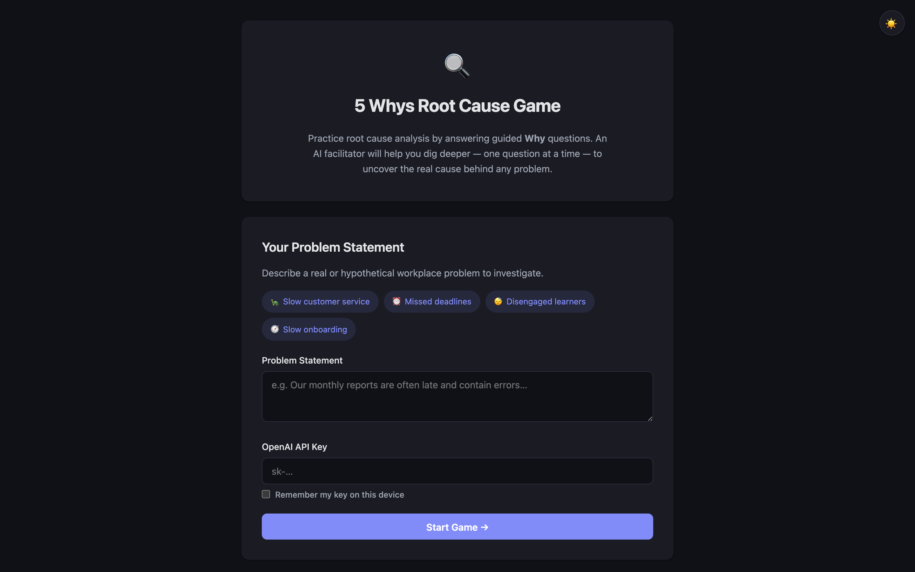
ACTIVITY 6 · TOOL
The Tool — 5 Whys
Open it in your browser
https://alfredang.github.io/5whys/
No install, no login
It runs in the browser. Work on one shared screen as a team.
Build the artefact
The deliverable named on the next slide.
Export it
Screenshot or export into your Activity worksheet.
Activity 6 · 45 minutes · full step-by-step: Learner Guide, Activity 6
Agile Project Management for Business · TGS-2023018967
© 2026 Tertiary Infotech Academy Pte Ltd
102

Slide 103
TOPIC 03 · HANDS-ON ACTIVITY
ACTIVITY 6 · 45 MIN
Run the Sprint Retrospective with 5 Whys Root-Cause Analysis
THE SITUATION
Sprint 1 finished 6 of 20 committed points short. In the review, one customer noted that the shipment status feature 'works but shows yesterday's data'. In the retrospective, the team's first instinct is to blame the carrier data feed. The Scrum Master pushes for a real root cause, because the same class of problem appeared twice in the old waterfall project.
WHAT YOU'LL DO
YOU'LL PRODUCE
DONE WHEN
Your team runs a full retrospective in the five stages, using the 5 Whys tool on the single highest-impact problem from Sprint 1. You drive past the first plausible answer to a root cause the team can actually act on, then convert it into one SMART action with a named owner that enters the Sprint 2 backlog as a real item.
A completed 5 Whys chain of at least 5 levels reaching an actionable root cause, plus one SMART improvement action with a named owner, a measure, and a place in the Sprint 2 backlog.
Your chain reaches a process or system cause the team can change, not a person and not an external party. Reading it backwards with 'because' holds together at every link. Your SMART action has an owner, a measure and points in the Sprint 2 backlog. If your root cause is 'the carrier's fault', you stopped at Why 1.
ACT 6
Tool: 5 Whys — https://alfredang.github.io/5whys/
LO 3 · Assess work performance and quality to ensure continuous improvement, drilling to the root cause of a delivery problem (A6, A7). · Full step-by-step: Learner Guide, Activity 6
Agile Project Management for Business · TGS-2023018967
© 2026 Tertiary Infotech Academy Pte Ltd
103

Slide 104
TOPIC 03 · ACTIVITY 6 DEBRIEF
Debrief — Activity 6: What It Proves
Stopping at 'the carrier feed was stale' would have produced a ticket. Reaching the copied Definition of Done produced a systemic fix.
1
A root cause you cannot act on is not a root cause — it is an excuse with a diagram.
2
This is A6 in practice: assessing work performance and quality to drive continuous improvement, with PDCA closing the loop in the next sprint.
3
SUCCESS CRITERION
Your chain reaches a process or system cause the team can change, not a person and not an external party. Reading it backwards with 'because' holds together at every link. Your SMART action has an owner, a measure and points in the Sprint 2 backlog. If your root cause is 'the carrier's fault', you stopped at Why 1.
Agile Project Management for Business · TGS-2023018967
© 2026 Tertiary Infotech Academy Pte Ltd
104

Slide 105
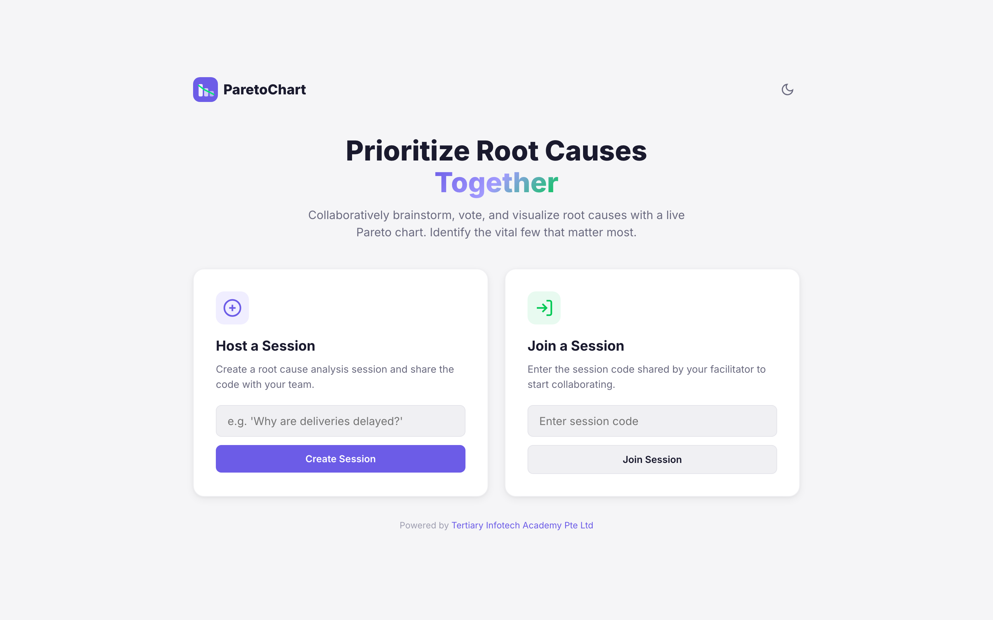
ACTIVITY 7 · TOOL
The Tool — Pareto Chart
Open it in your browser
https://alfredang.github.io/paretochart/
No install, no login
It runs in the browser. Work on one shared screen as a team.
Build the artefact
The deliverable named on the next slide.
Export it
Screenshot or export into your Activity worksheet.
Activity 7 · 45 minutes · full step-by-step: Learner Guide, Activity 7
Agile Project Management for Business · TGS-2023018967
© 2026 Tertiary Infotech Academy Pte Ltd
105

Slide 106
TOPIC 03 · HANDS-ON ACTIVITY
ACTIVITY 7 · 45 MIN
Prioritise Defect Causes with a Pareto Chart
THE SITUATION
Three sprints in, CustomerConnect has accumulated 120 logged defects. The team has capacity to attack roughly two root causes in Sprint 4, and the operations manager wants all 120 fixed. The Scrum Master has categorised every defect by cause and wants the team to decide with data rather than by whoever complains loudest.
WHAT YOU'LL DO
YOU'LL PRODUCE
DONE WHEN
Your team loads the 120-defect dataset into the Pareto tool, builds the ranked bar chart with the cumulative percentage line, identifies the vital few causes crossing the 80% threshold, and converts that finding into a Sprint 4 commitment with a measurable target. You then confront the trade-off with the operations manager.
A completed Pareto chart of 8 defect categories with a cumulative line, the identified vital few, and a Sprint 4 improvement commitment with a numeric target and the projected defect reduction.
Your chart is sorted descending, the cumulative line reaches 100%, and your vital few are justified by the crossing point rather than chosen by intuition. Your Sprint 4 target is numeric and verifiable. If your recommendation is 'fix everything', you have not used the chart to make a decision.
ACT 7
Tool: Pareto Chart — https://alfredang.github.io/paretochart/
LO 3 · Measure progress against targets and reduce waste and defects by identifying the few causes driving most of the failures (A3, A4, A6). · Full step-by-step: Learner Guide, Activity 7
Agile Project Management for Business · TGS-2023018967
© 2026 Tertiary Infotech Academy Pte Ltd
106

Slide 107
TOPIC 03 · ACTIVITY 7 DEBRIEF
Debrief — Activity 7: What It Proves
Pareto turns 'everything is broken' into 'two things are broken and they cause most of it'.
1
Activities 6 and 7 combine: 5 Whys finds the cause, Pareto proves it is the one worth fixing first.
2
This is A3 and A4 in practice: reducing waste and defects, and measuring against a defined target rather than an impression.
3
SUCCESS CRITERION
Your chart is sorted descending, the cumulative line reaches 100%, and your vital few are justified by the crossing point rather than chosen by intuition. Your Sprint 4 target is numeric and verifiable. If your recommendation is 'fix everything', you have not used the chart to make a decision.
Agile Project Management for Business · TGS-2023018967
© 2026 Tertiary Infotech Academy Pte Ltd
107

Slide 108
ACTIVITY 8 · TOOL
The Tool — Scrum Board
Open it in your browser
https://alfredang.github.io/scrum/
No install, no login
It runs in the browser. Work on one shared screen as a team.
Build the artefact
The deliverable named on the next slide.
Export it
Screenshot or export into your Activity worksheet.
Activity 8 · 45 minutes · full step-by-step: Learner Guide, Activity 8
Agile Project Management for Business · TGS-2023018967
© 2026 Tertiary Infotech Academy Pte Ltd
108

Slide 109
TOPIC 03 · HANDS-ON ACTIVITY
ACTIVITY 8 · 45 MIN
Forecast the Release from Velocity and Read the Agile Metrics
THE SITUATION
The HarbourFront committee meets on Friday and wants one answer: when will the remaining CustomerConnect scope be delivered? The team has completed 4 sprints with velocities of 14, 18, 17 and 21 points. There are 186 points left in the backlog. The programme director wants a single date. The operations manager has separately asked why the support queue keeps growing despite the team 'going faster'.
WHAT YOU'LL DO
YOU'LL PRODUCE
DONE WHEN
Your team computes average velocity, builds a forecast range rather than a single date, plots a release burndown, and interprets a supplied cumulative flow diagram and control chart to locate the bottleneck behind the growing support queue. You then write the committee answer — a range with its assumptions stated.
A velocity-based forecast range in sprints and calendar dates, a release burndown, a written interpretation of the CFD and control chart naming the bottleneck, and a one-paragraph answer to the committee.
Your answer is a range with assumptions, not a single date. You identify Testing as the bottleneck from the CFD and confirm it with the control chart. You explain the growing queue with Little's Law. If your recommendation is 'increase velocity', re-read the control chart — that is what caused the problem.
ACT 8
Tool: Scrum Board — https://alfredang.github.io/scrum/
LO 3 · Measure progress against targets for defined business outcomes and forecast delivery from empirical data (A4, A6, A7). · Full step-by-step: Learner Guide, Activity 8
Agile Project Management for Business · TGS-2023018967
© 2026 Tertiary Infotech Academy Pte Ltd
109

Slide 110
TOPIC 03 · ACTIVITY 8 DEBRIEF
Debrief — Activity 8: What It Proves
Five metrics, one story: burndown for the sprint, release burndown for the release, velocity for the forecast, control chart for cycle time, CFD for the bottleneck.
1
Velocity up and cycle time up at the same time always means WIP is up. Little's Law is not optional arithmetic.
2
This is A4 in practice: measuring progress against targets for defined business outcomes — and being honest with the committee about uncertainty.
3
SUCCESS CRITERION
Your answer is a range with assumptions, not a single date. You identify Testing as the bottleneck from the CFD and confirm it with the control chart. You explain the growing queue with Little's Law. If your recommendation is 'increase velocity', re-read the control chart — that is what caused the problem.
Agile Project Management for Business · TGS-2023018967
© 2026 Tertiary Infotech Academy Pte Ltd
110

Slide 111
TOPIC RECAP · LO3 · K5, A4, A6, A7
Recap — Agile Project Execution and Tracking
1
Activity 5 · Execute Sprint 1 and Track It on the Scrum Board
Measure progress against targets on a regular basis by executing a sprint on a live board and reading the burndown (K5, A4, A7).
2
Activity 6 · Run the Sprint Retrospective with 5 Whys Root-Cause Analysis
Assess work performance and quality to ensure continuous improvement, drilling to the root cause of a delivery problem (A6, A7).
3
Activity 7 · Prioritise Defect Causes with a Pareto Chart
Measure progress against targets and reduce waste and defects by identifying the few causes driving most of the failures (A3, A4, A6).
4
Activity 8 · Forecast the Release from Velocity and Read the Agile Metrics
Measure progress against targets for defined business outcomes and forecast delivery from empirical data (A4, A6, A7).
Agile Project Management for Business · TGS-2023018967
© 2026 Tertiary Infotech Academy Pte Ltd
111

Slide 112
WRAP-UP
Course Summary & Next Steps
Agile Project Management for Business · TGS-2023018967
© 2026 Tertiary Infotech Academy Pte Ltd
112

Slide 113
LEARNING OUTCOMES ACHIEVED
What You Can Now Do
LO1 — Adopt the Agile mindset
You can explain why waterfall concentrates risk, diagnose a failed delivery, and reframe requirements around customer value.
1
LO2 — Share and implement practices
You can apply the Manifesto, run Scrum, build an ordered backlog, plan a sprint and clarify accountability.
2
LO3 — Build, execute and track
You can run a sprint, read all five Agile metrics, find a root cause and forecast a release honestly.
3
Agile Project Management for Business · TGS-2023018967
© 2026 Tertiary Infotech Academy Pte Ltd
113

Slide 114
THE TAKEAWAYS
The Eight Things Worth Remembering
1
Fixed time, variable scope
2
Value early beats value complete
3
The sprint goal makes a sprint
4
Done means Done
That inversion is the whole paradigm shift.
Shipping 20% of scope in month two changes the return profile.
Without one you have a task list with a deadline.
Carryover is never velocity, and 'nearly' is not a status.
5
One Accountable per decision
6
Limit WIP to go faster
7
Velocity forecasts, never targets
8
Actions need owners
Two Product Owners is the most common Agile failure.
Little's Law: cycle time = WIP ÷ throughput.
Reward it and you destroy it.
An improvement with no owner and no capacity is a wish.
IF YOU REMEMBER ONE THING
Agile is not a faster way to build what you were told to build. It is a disciplined way to keep finding out what is actually worth building — and to stop building what is not.
Agile Project Management for Business · TGS-2023018967
© 2026 Tertiary Infotech Academy Pte Ltd
114

Slide 115
RECOMMENDED COURSES
Where to Go Next
1
WSQ - Fast-Track Innovations with Agile Design Thinking and Generative AI (GenAI)
www.tertiarycourses.com.sg
2
WSQ - Design Thinking Course for Businesses
www.tertiarycourses.com.sg
3
WSQ - Effective Project Management for Small Projects
www.tertiarycourses.com.sg
4
WSQ - Innovative Problem Solving with Generative AI (GenAI)
www.tertiarycourses.com.sg
5
WSQ - Mastering Agile Project Management for IT Projects
www.tertiarycourses.com.sg
Agile Project Management for Business · TGS-2023018967
© 2026 Tertiary Infotech Academy Pte Ltd
115

Slide 116
ASSESSMENT · NOW
Final Assessment
1
Written Assessment (WA)
Written Assessment (WA) — Short-Answer Questions (SAQ), 1 hour, open book.
2
Case Study (CS)
Case Study (CS) — an applied business scenario with structured tasks, 1 hour, open book.
3
Open book
Open book: slides, Learner Guide and approved course materials only.
4
Competency
A minimum of 75% attendance is required to be eligible for assessment and funding. Learners must be assessed Competent in both instruments.
Agile Project Management for Business · TGS-2023018967
© 2026 Tertiary Infotech Academy Pte Ltd
116

Slide 117
ASSESSMENT · END-TO-END FLOW
Assessment Flow
You must be assessed Competent in BOTH instruments. Feedback and an appeal route are available at the end.
Agile Project Management for Business · TGS-2023018967
© 2026 Tertiary Infotech Academy Pte Ltd
117

Slide 118
ADMIN · TRAQOM & CERTIFICATION
Certificate & TRAQOM Survey (Mandatory)
https://lms-tms.tertiaryinfotech.com
1
Log in to lms-tms.tertiaryinfotech.com
Log in with your registered email
2
Complete the mandatory TRAQOM survey
Course feedback complete the TRAQOM survey
3
Submit the Assessment digital attendance
Digital attendance Assessment attendance must be submitted
4
Download your Certificate of Achievement
Certificate download once assessed Competent
5
Your OpenCert from SSG follows by email
TRAQOM completion and 75% attendance are both mandatory for WSQ funding.
Agile Project Management for Business · TGS-2023018967
© 2026 Tertiary Infotech Academy Pte Ltd
118

Slide 119
WE'RE HERE AFTER THE COURSE TOO
Support
Email
enquiry@tertiaryinfotech.com
Telephone
+65 6100 0613
1
2
Website
www.tertiarycourses.com.sg
LMS / TMS
https://lms-tms.tertiaryinfotech.com
3
4
Agile Project Management for Business · TGS-2023018967
© 2026 Tertiary Infotech Academy Pte Ltd
119

Slide 120
Thank You!
Agile Project Management for Business
TGS-2023018967 · Tertiary Infotech Academy Pte Ltd · UEN: 201200696W

